Slide 1
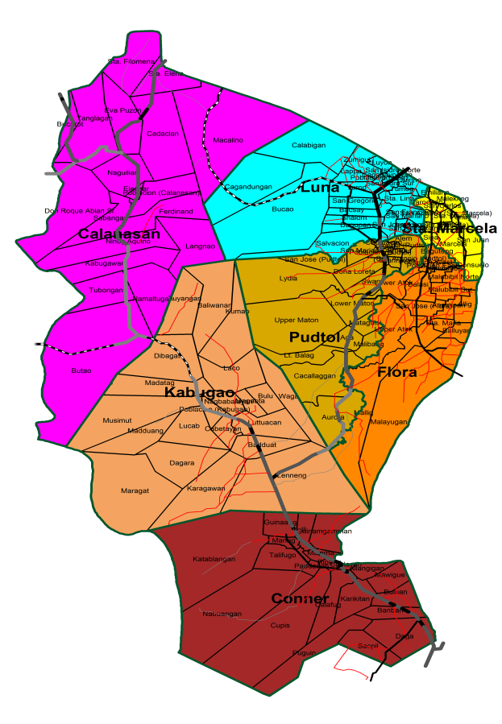
CARAA 2
WELCOME TO APAYAO
13

Slide 2
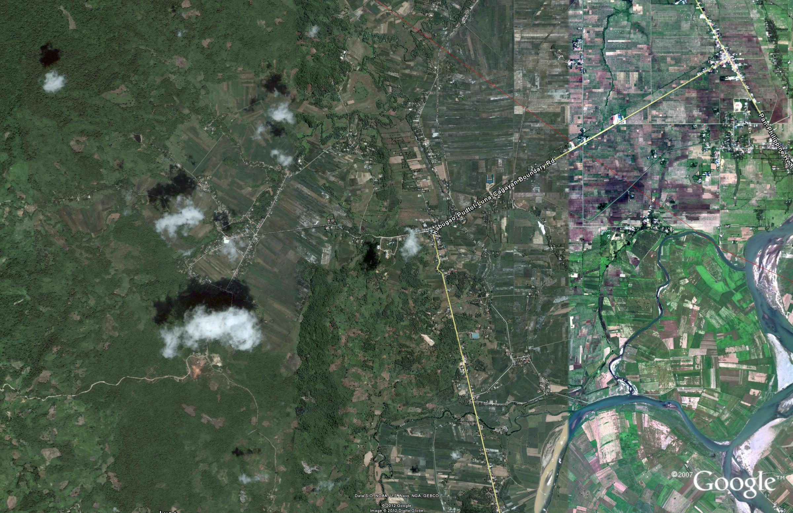
ON THIS SITE
APAYAO EC0-TOURISM AND SPORTS COMPLEX

Slide 3
APAYAO ECO-TOURISM AND SPORTS COMPLEX
PLAYING VENUES FOR:
ARCHERY
ATHLETICS
BASEBALL
CHESS
FOOTBALL/SOCCER

Slide 4
SIPA/SEPAK TAKRAW
SOFTBALL
SWIMMING
LAWN TENNIS (SECONDARY)
VOLLEYBALL

Slide 5
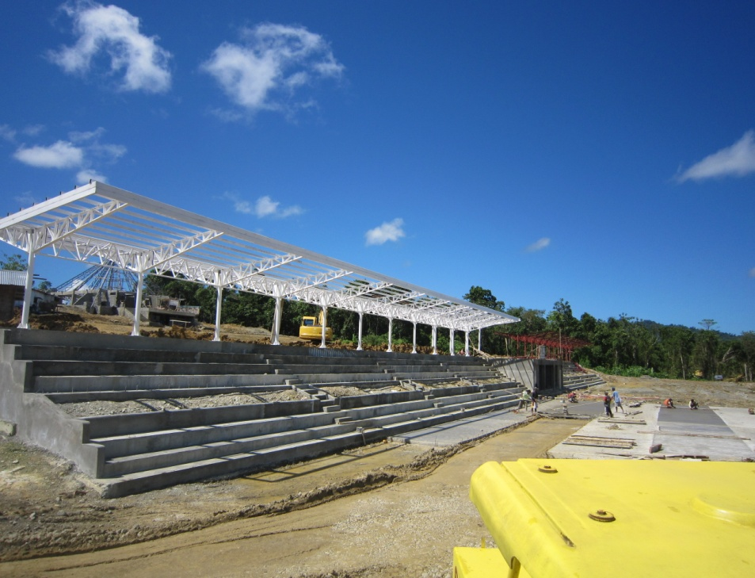
ON THIS SITE
APAYAO GRANDSTAND

Slide 6
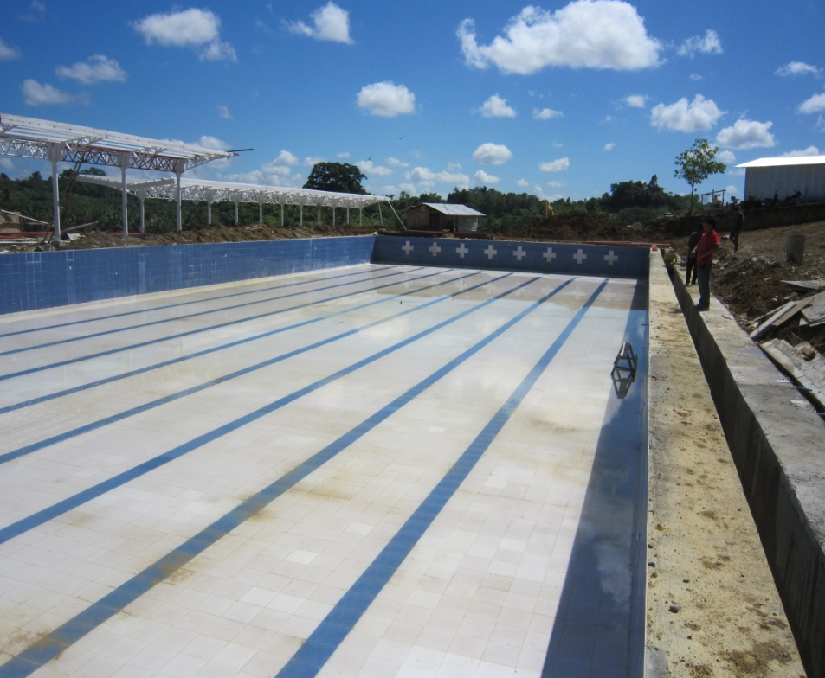
ON THIS SITE
OLYMPIC SIZE SWIMMING
POOL

Slide 7
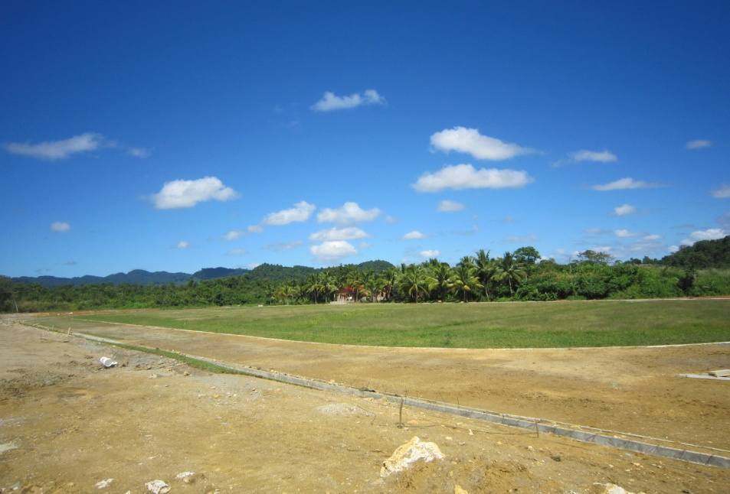
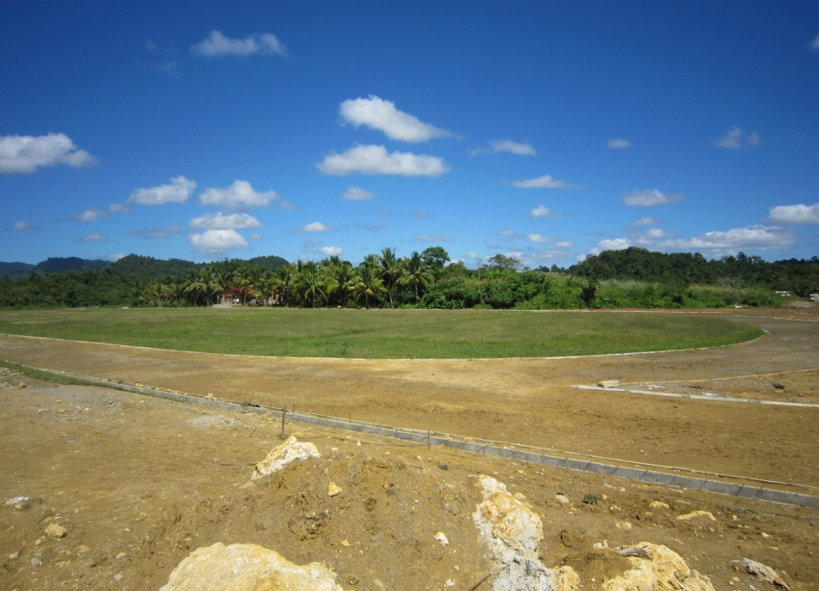
ON THIS SITE
OVAL
OVAL

Slide 8
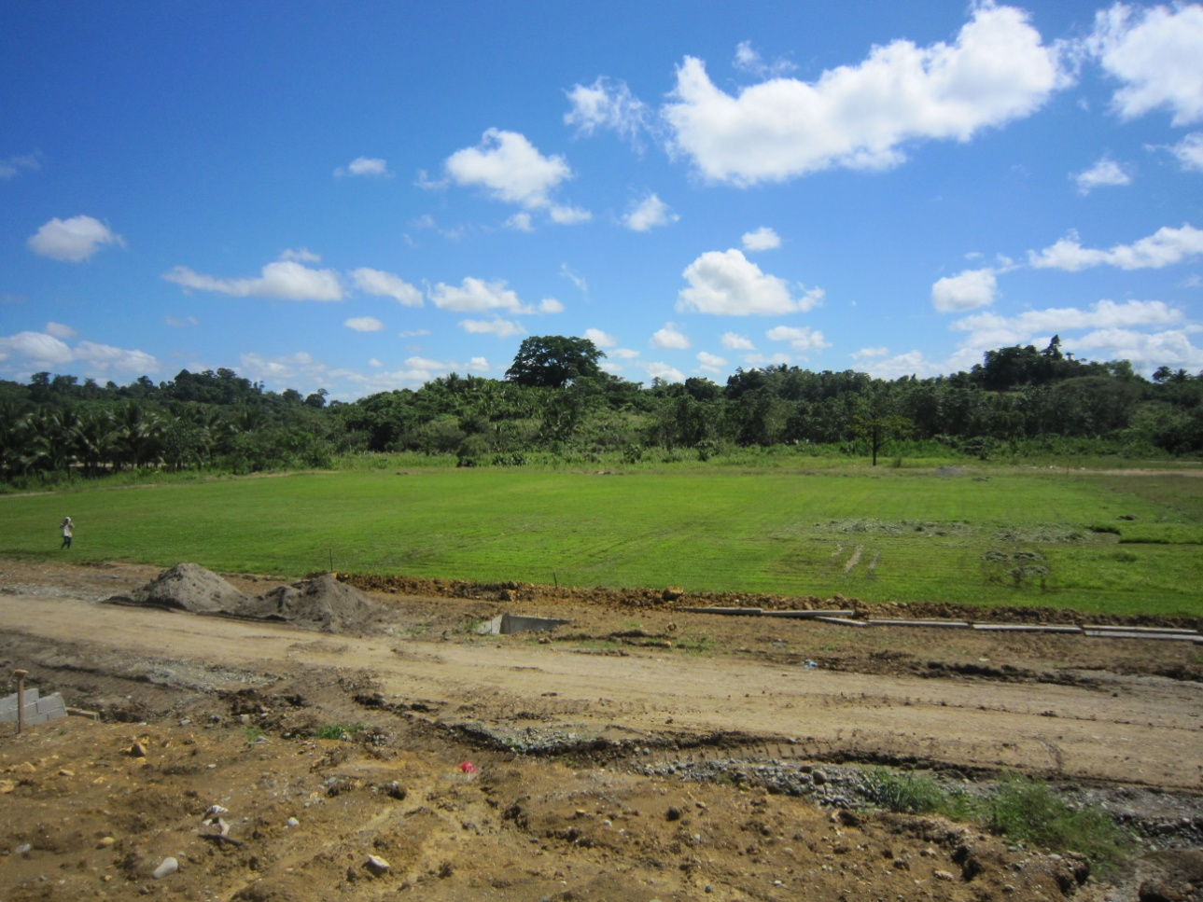
ON THIS SITE
SOCCER FIELD

Slide 9
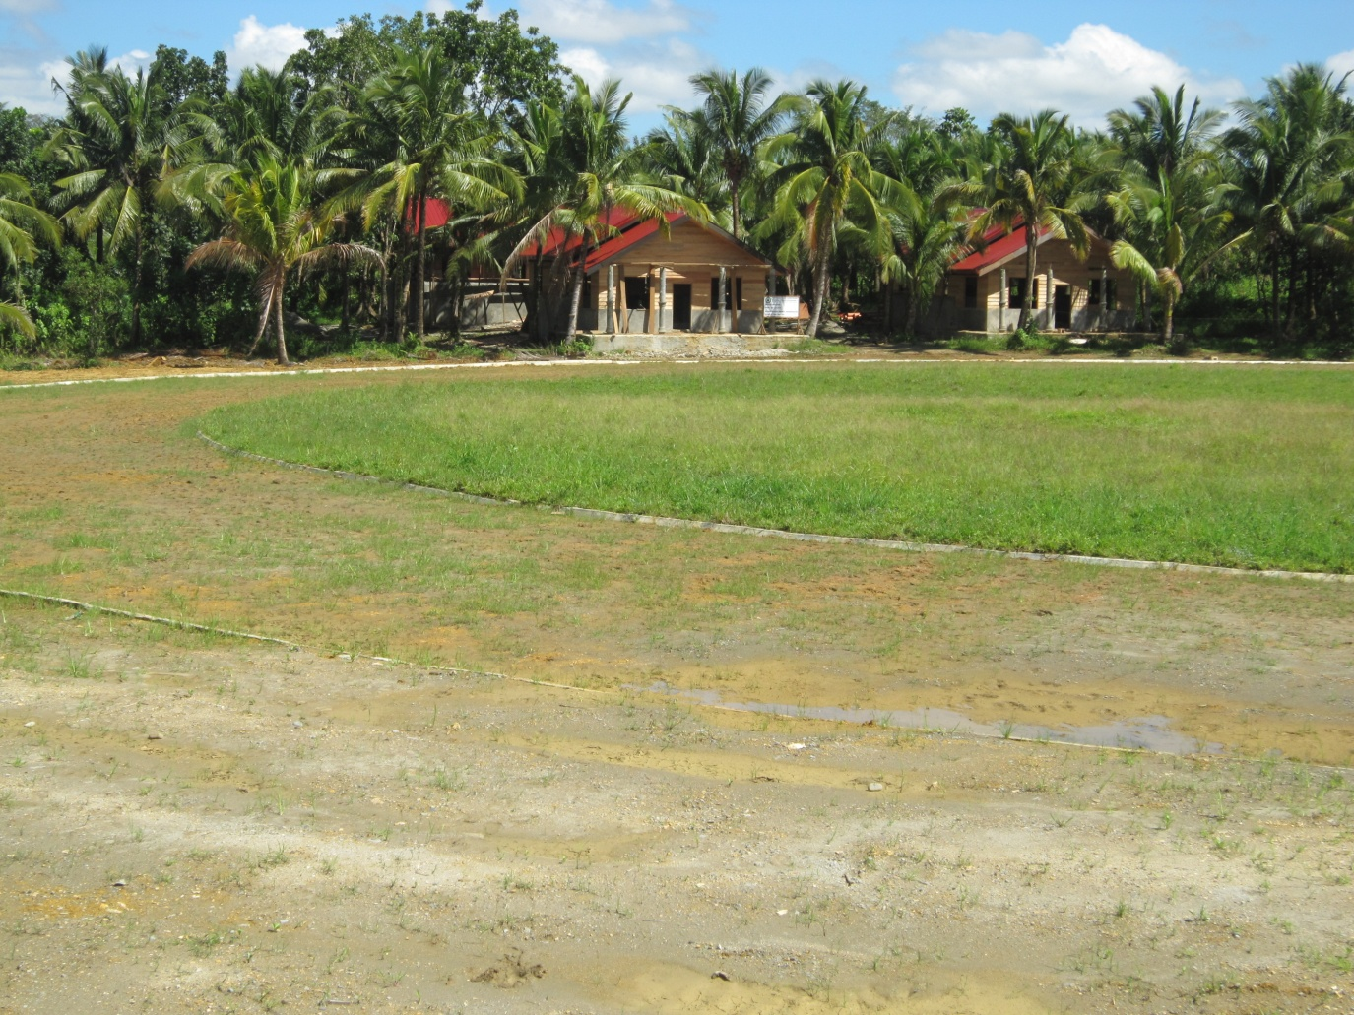
ON THIS SITE
GUEST HOUSE

Slide 10
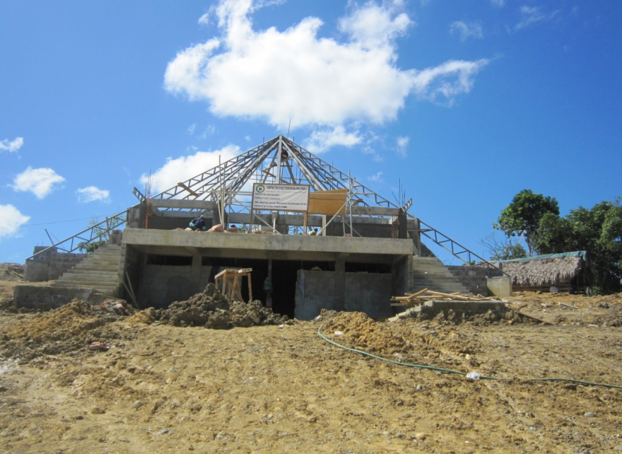
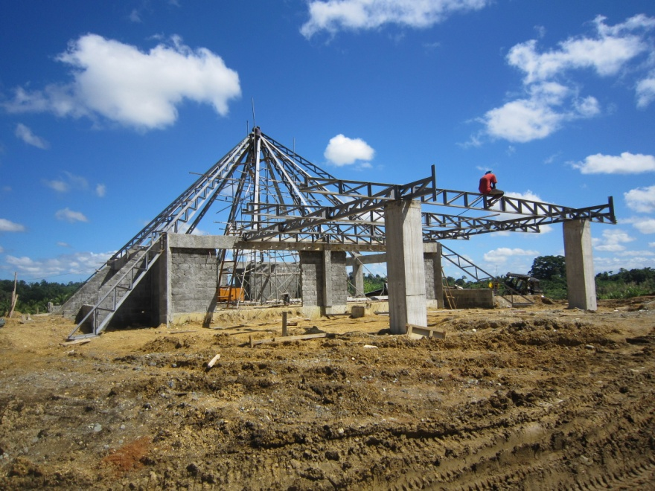
ON THIS SITE
THE CLUBHOUSE

Slide 11
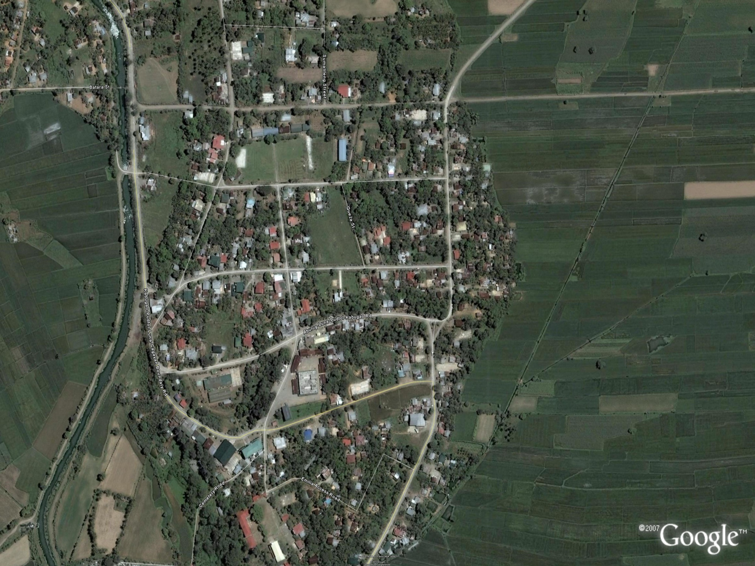
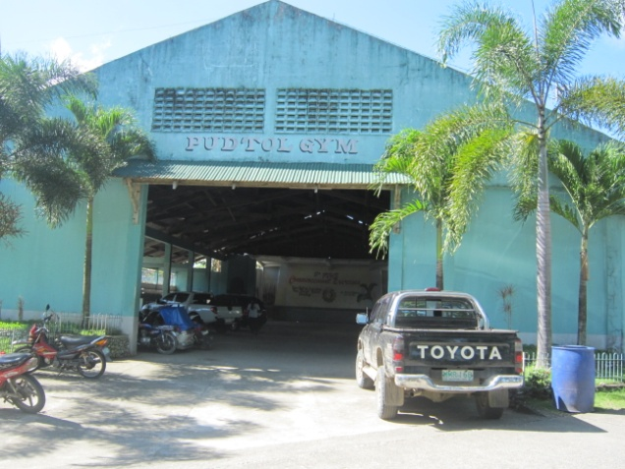
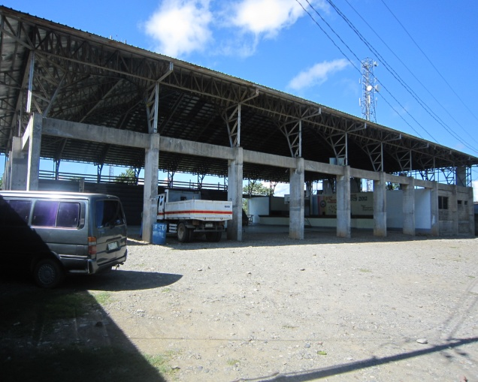
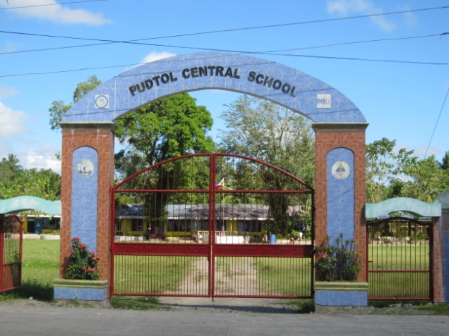
PUDTOL,APAYAO
PLAYING VENUE FOR:
ARNIS(PUDTOL,GYMNASIUM)
TAEKWONDO(PUDTOL,GYMNASIUM)
LAWN TENNIS (ELEMENTARY)
(PUDTOL CENTRAL SCHOOL)
DISTANCE FROM APETSC TO PUDTOL
10 KILOMETERS
15 MINUTES DRIVE

Slide 12
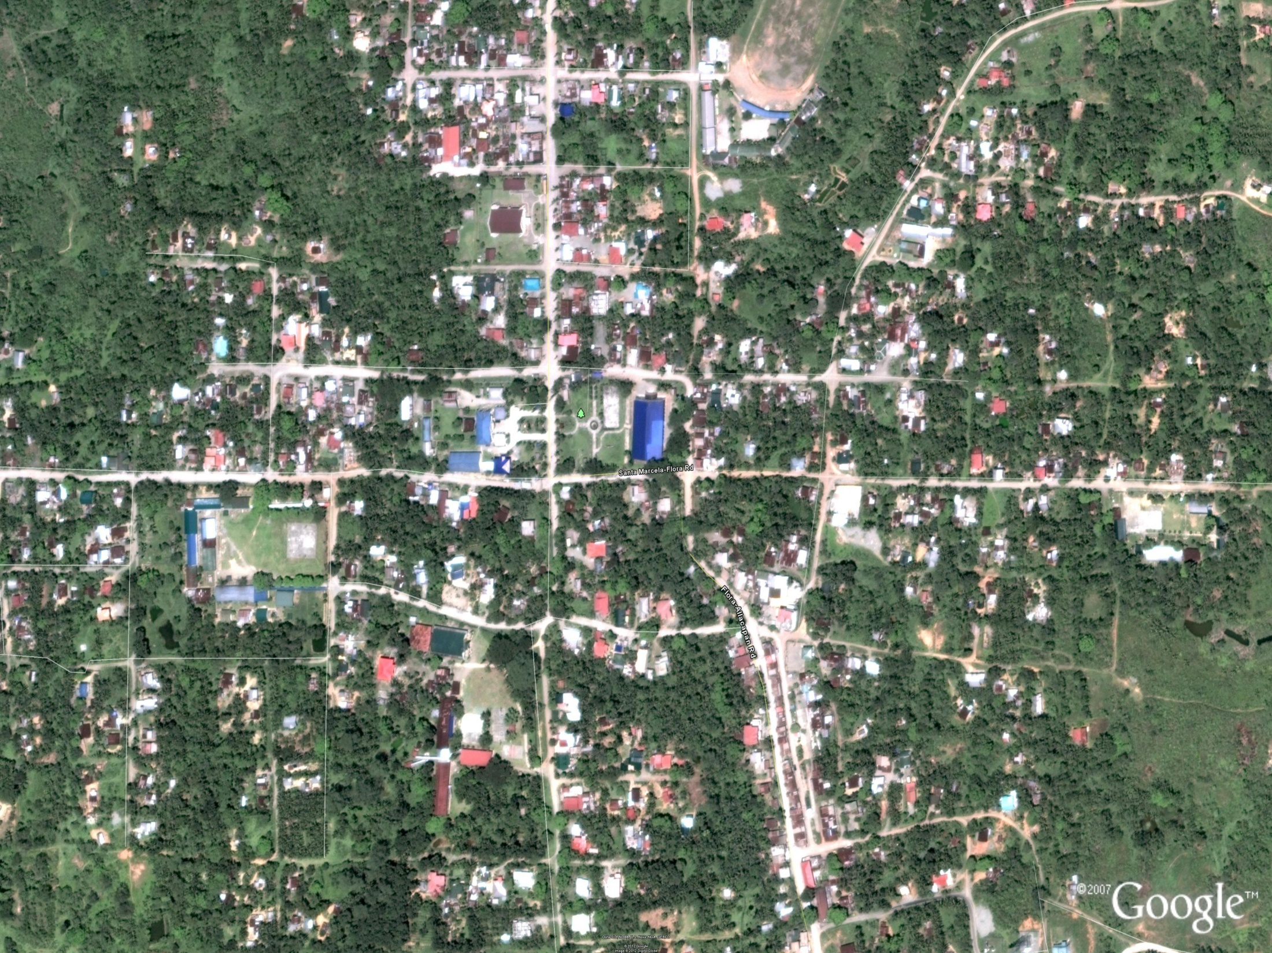
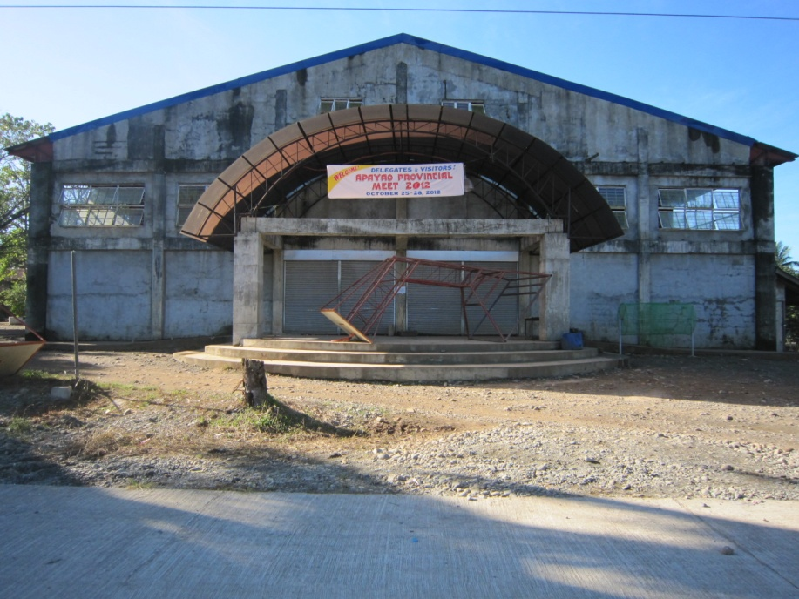
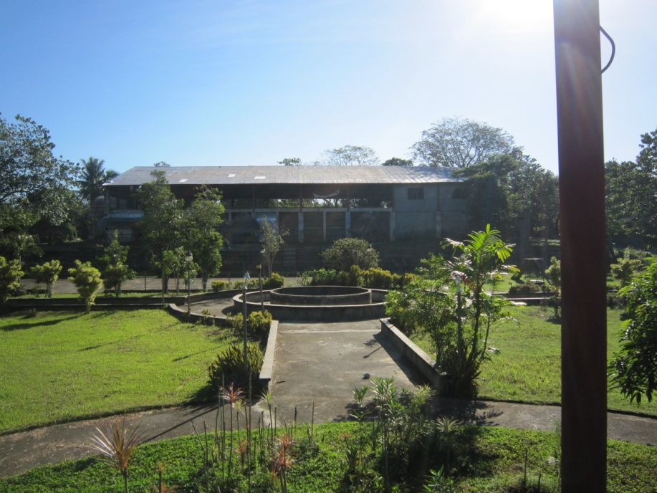
FLORA,APAYAO
PLAYING VENUE FOR:
BADMINTON(ELEMENTARY AND SECONDARY)
FLORA GYMNASIUM
DISTANCE FROM APETSC TO FLORA
32 KILOMETERS
45 MINUTES DRIVE

Slide 13
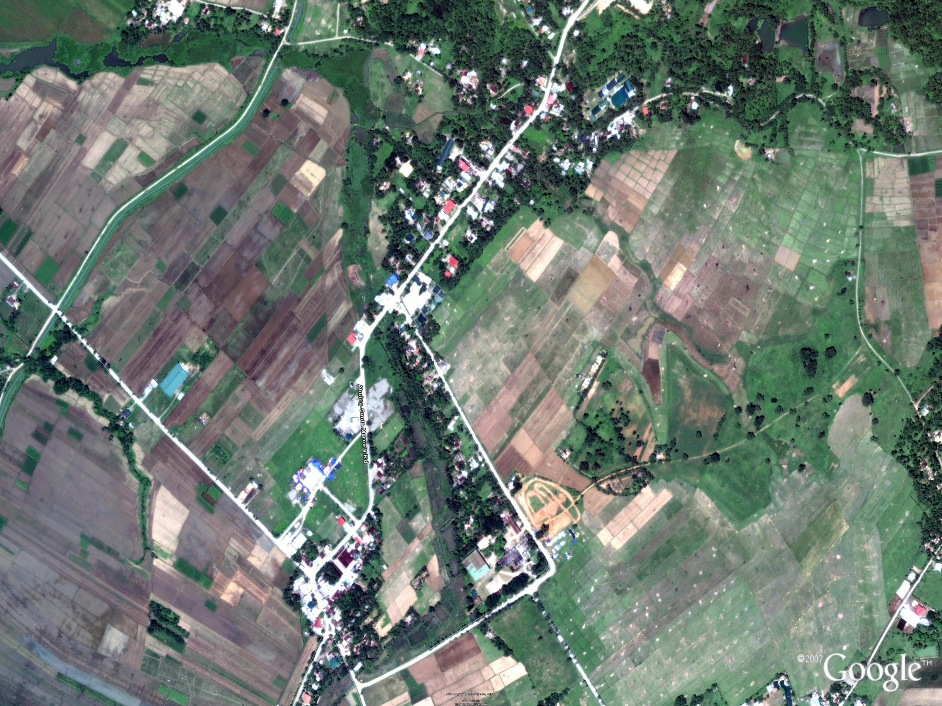
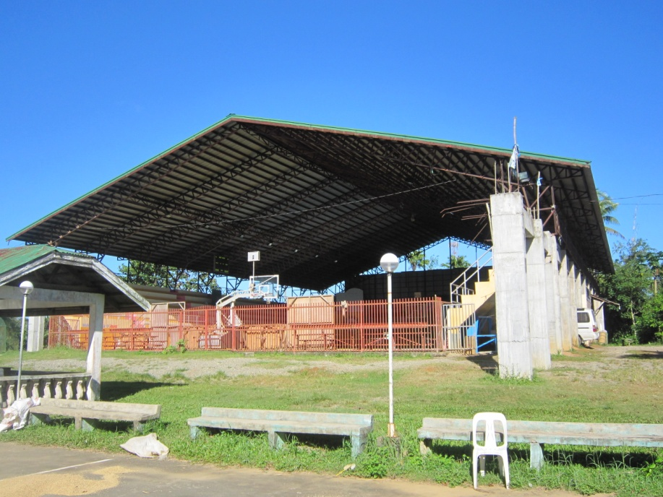
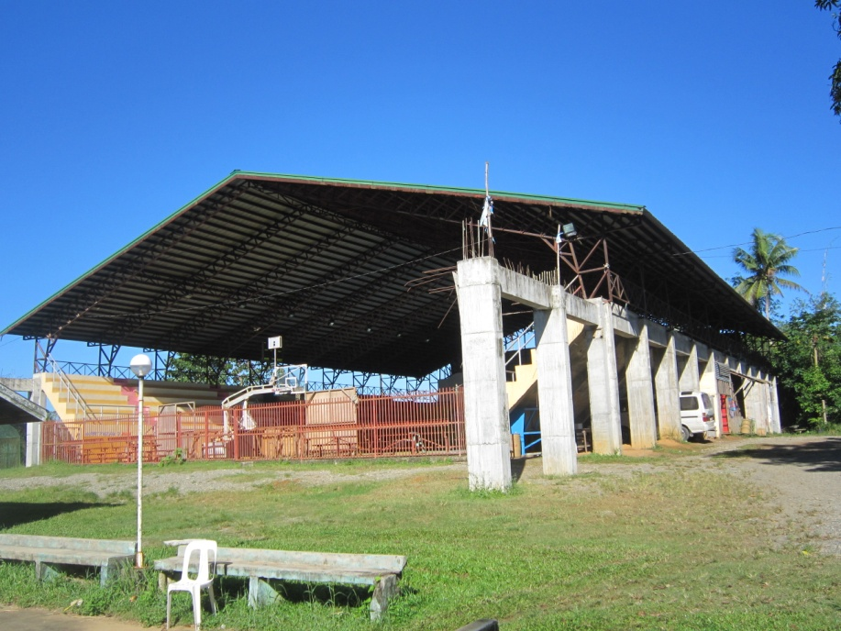
STA MARCELA,APAYAO
PLAYING VENUE FOR:
BASKETBALL (ELEMENTARY)
DISTANCE FROM APETSC TO STA MARCELA
25 KILOMETERS
30 MINUTES DRIVE

Slide 14
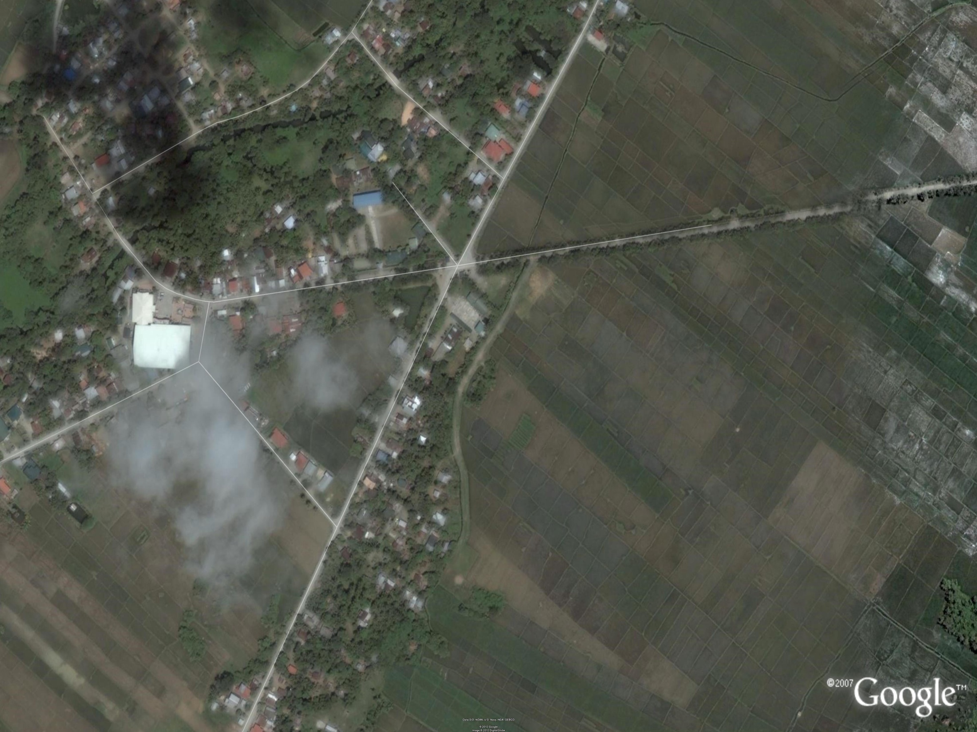
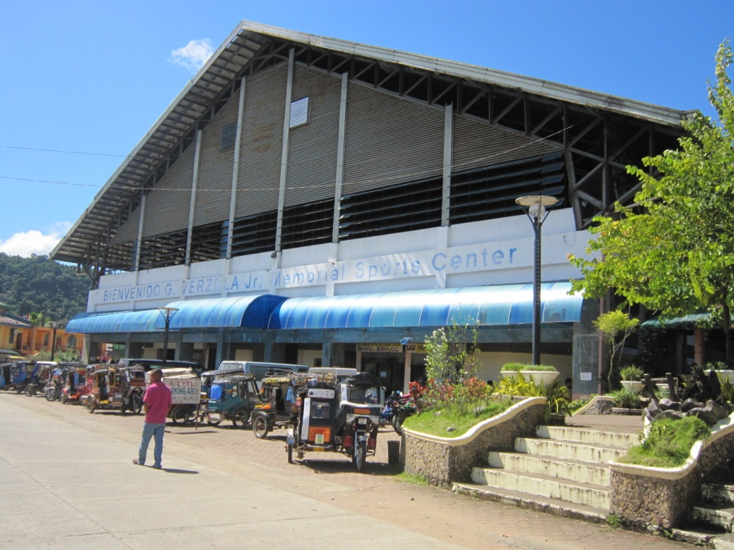
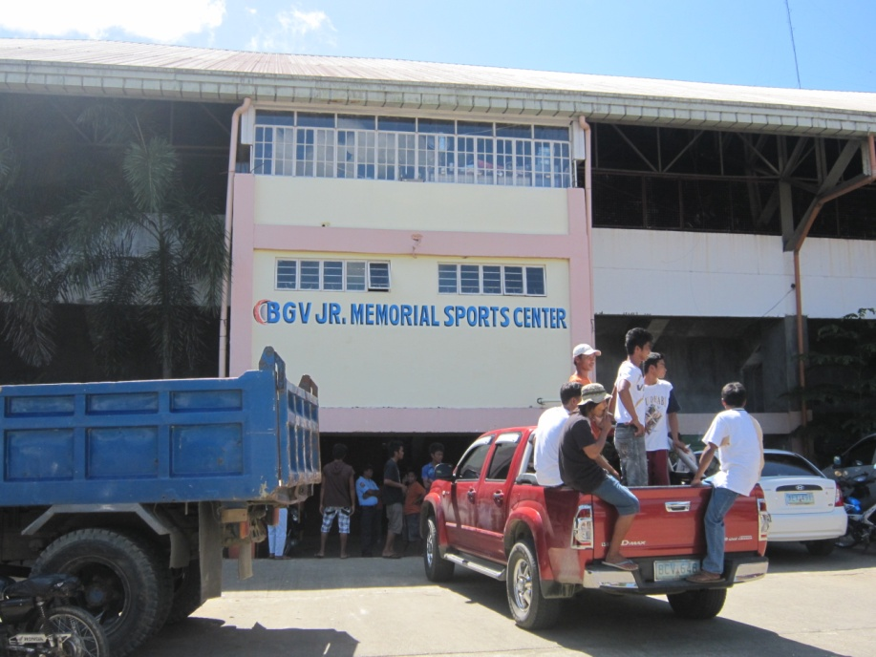
LUNA,APAYAO
PLAYING VENUE FOR:
BASKETBALL (SECONDARY)
BIENVENIDO VERZOLA, JR MEMORIAL SPORTS CENTER
DISTANCE FROM APETSC TO BVMSC
2 KILOMETERS
5 MINUTES DRIVE

Slide 15
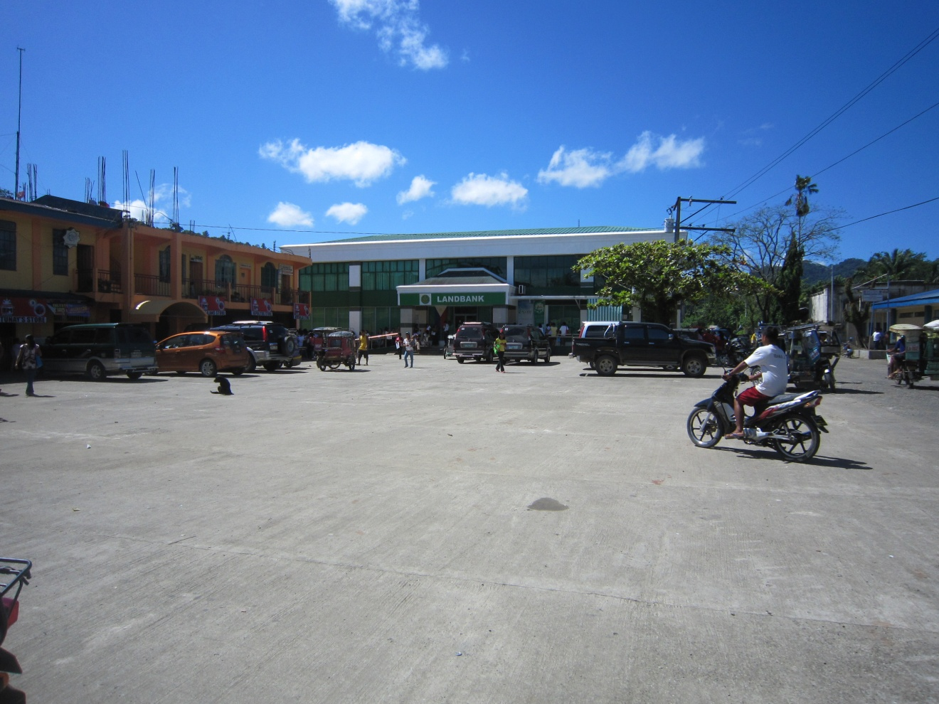
LUNA,APAYAO
PLAYING VENUE FOR:
BOXING (ELEMENTARY AND SECONDARY)
LAND BANK OPEN GROUND
DISTANCE FROM APETSC TO LANDBANK
2 KILOMETERS
5 MINUTES DRIVE

Slide 16
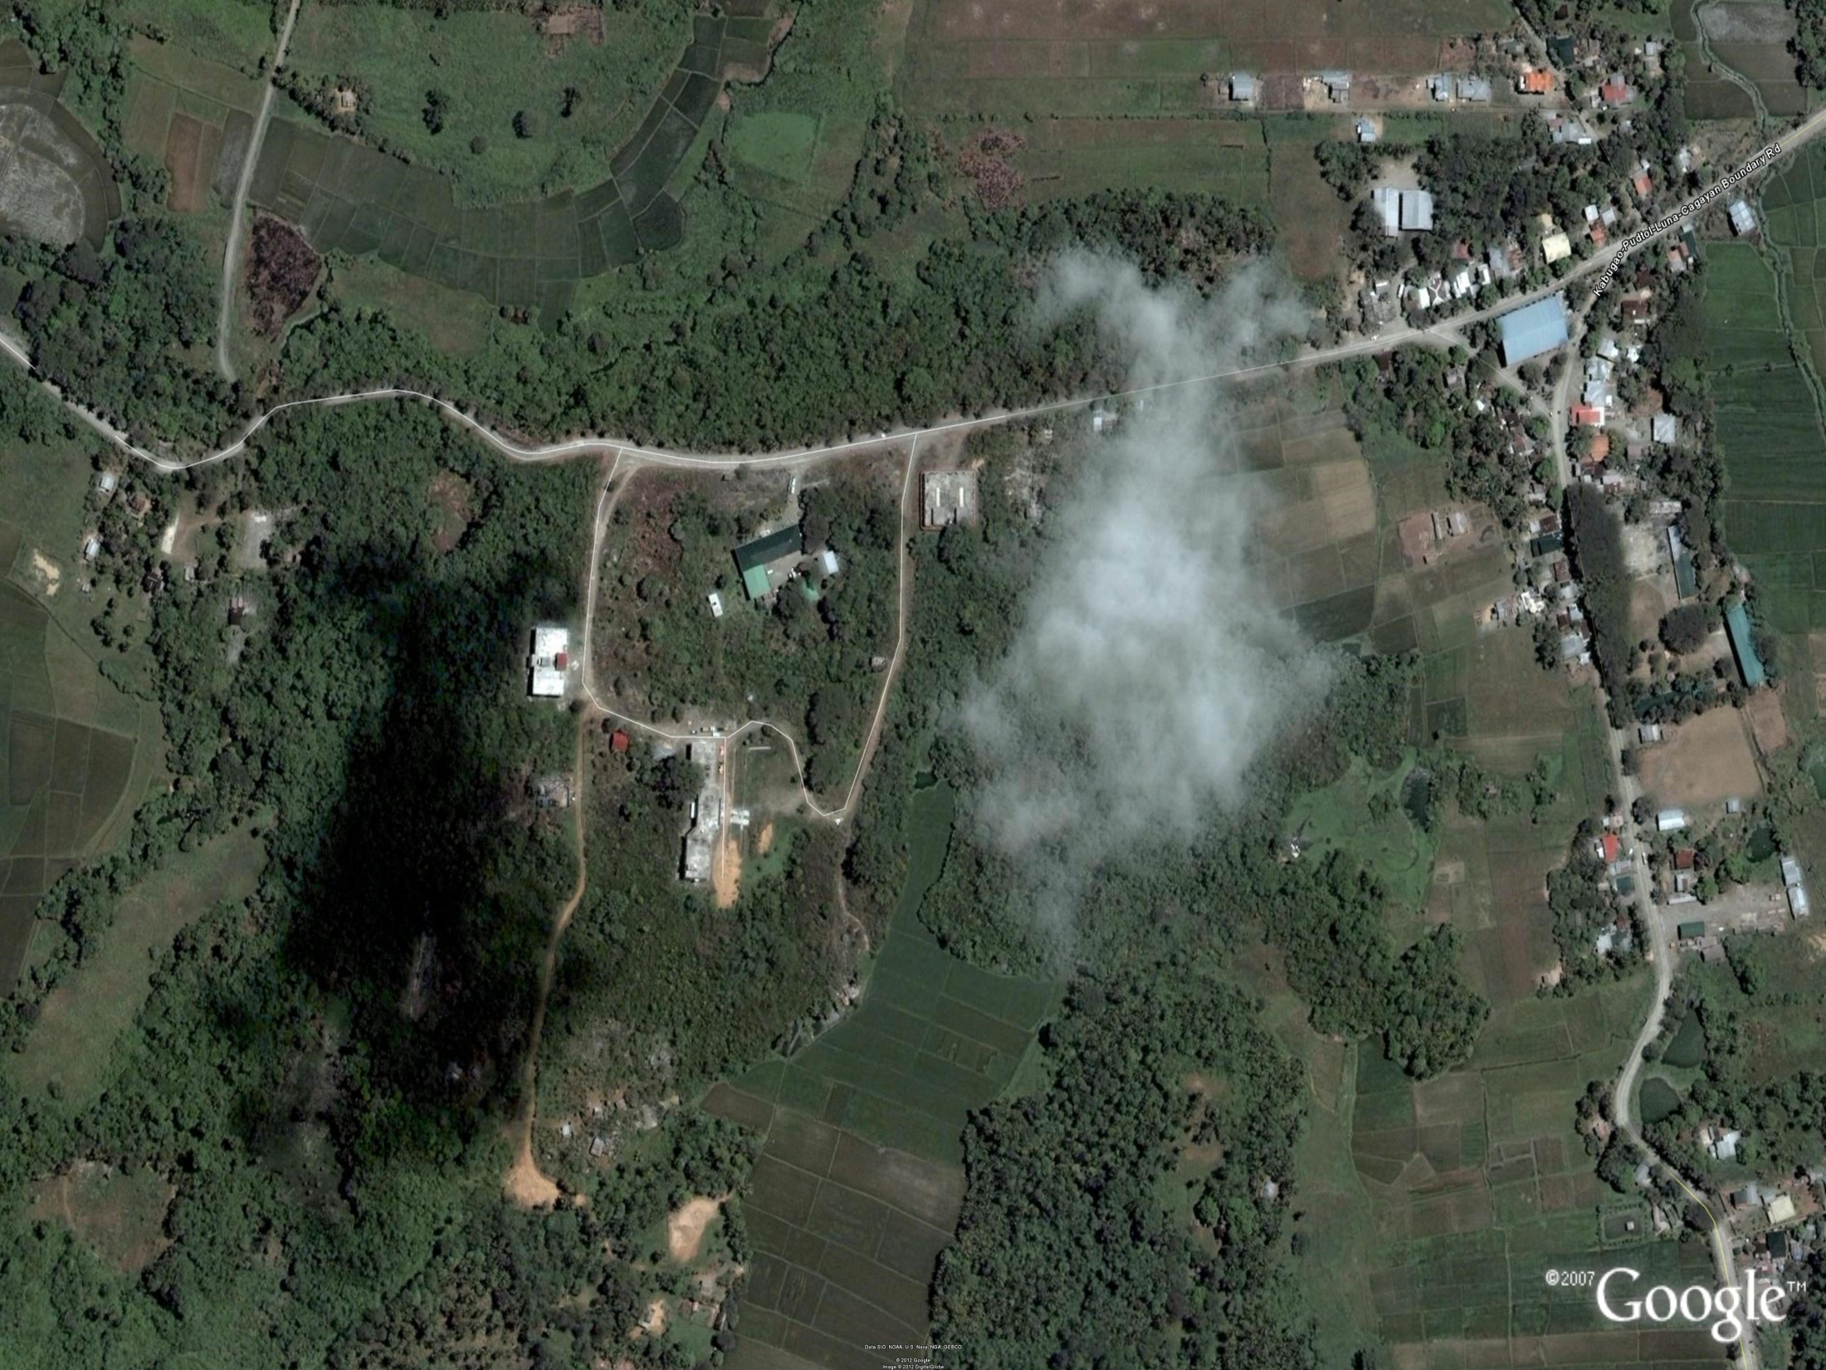
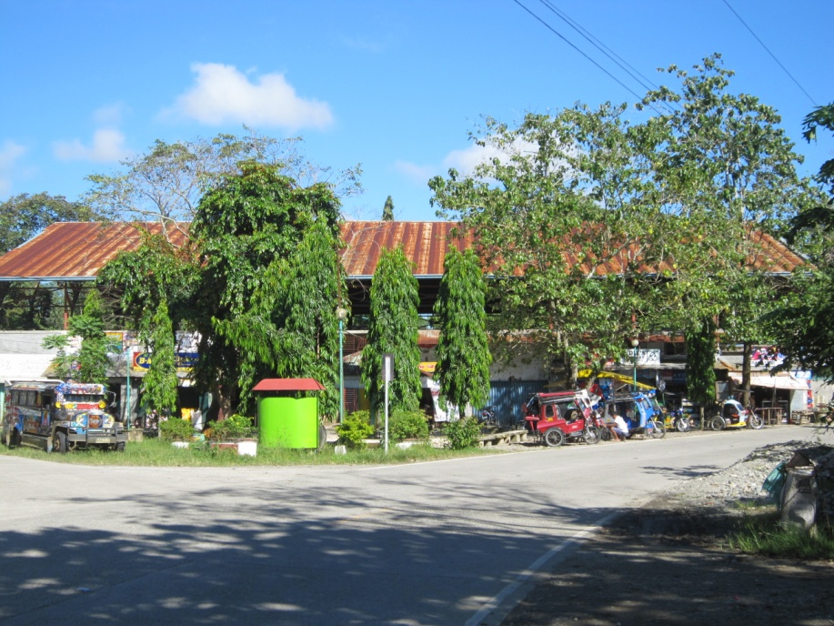
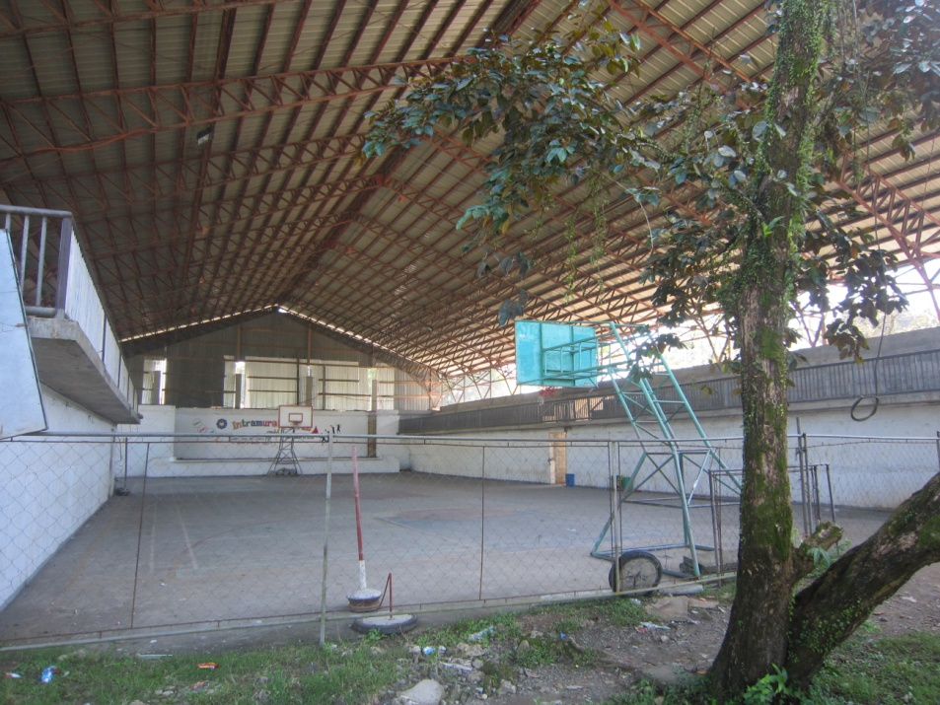
LUNA,APAYAO
PLAYING VENUE FOR:
GYMNASTICS ELEMENTARY AND SECONDARY
SAN ISIDRO GYMNASIUM
DISTANCE FROM APETSC TO SAN ISIDRO GYMNASIUM
5.5 KILOMETERS
9 MINUTES DRIVE

Slide 17
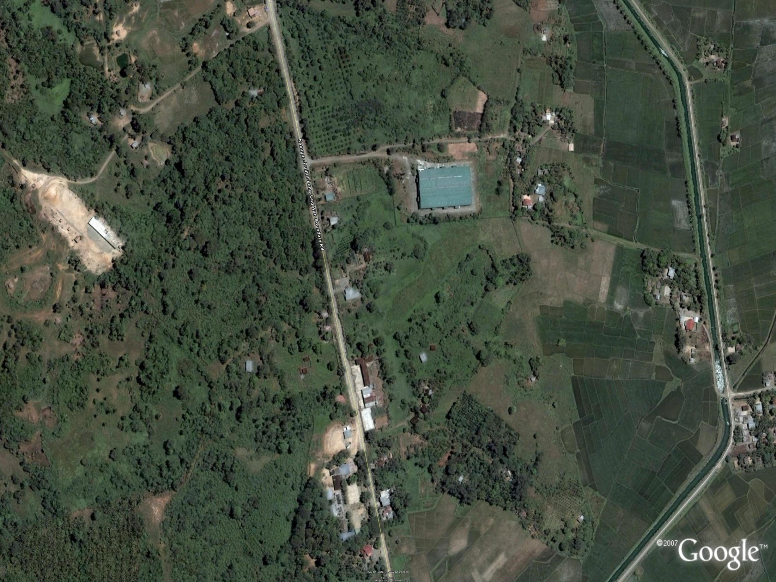
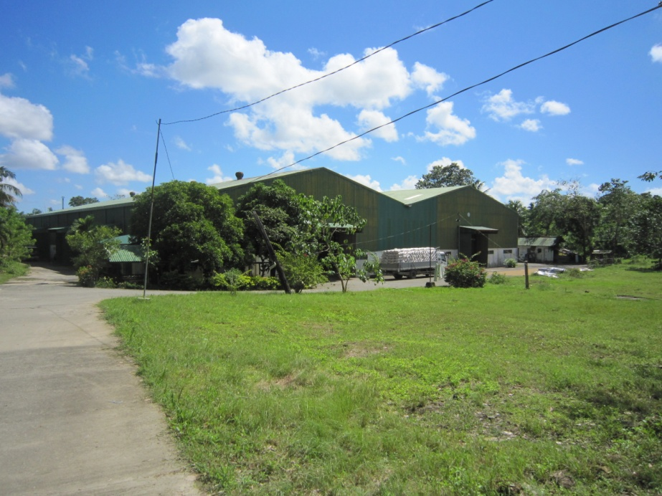
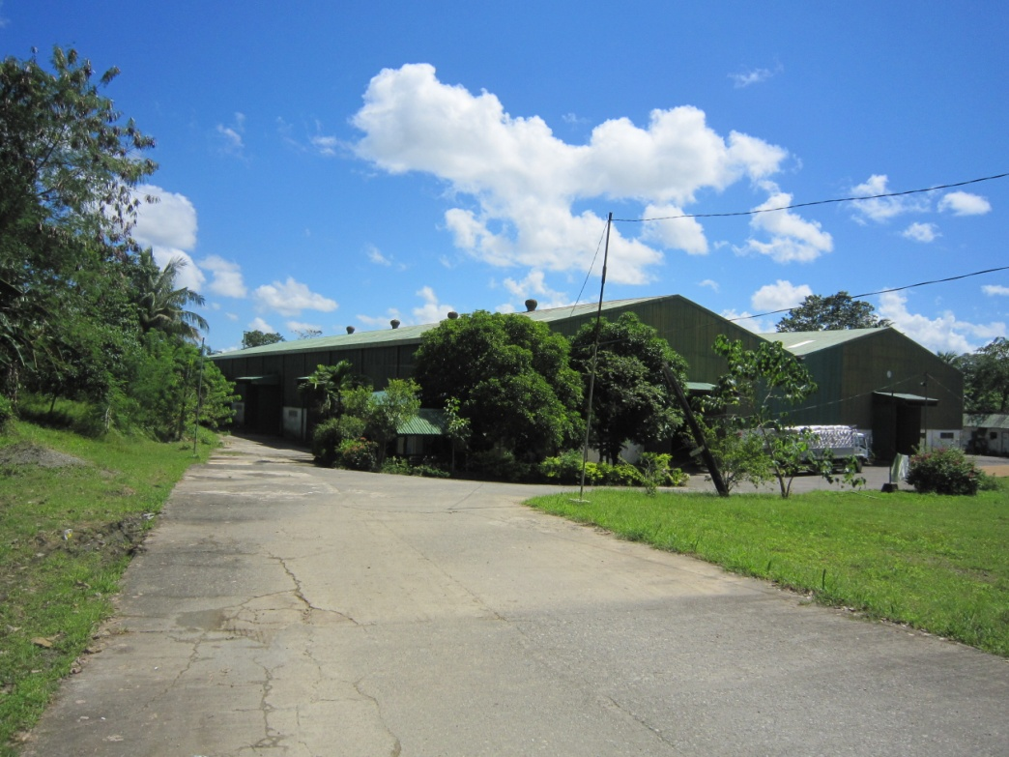
LUNA,APAYAO
PLAYING VENUE FOR:
TABLE TENNIS (ELEMENTARY AND SECONDARY)
NFA-TUMOG
DISTANCE FROM APETSC TO NFA-TUMOG
6 KILOMETERS
11 MINUTES DRIVE

Slide 18
CARAA 2
BILLETING SCHOOLS
13

Slide 19
HOST MUNICIPALITY: FLORA
HOST SCHOOLS: FLORA CENTRAL SCHOOL
SAINT JOSEPH HIGH SCHOOL
DELEGATION: KALINGA PROVINCE

Slide 20
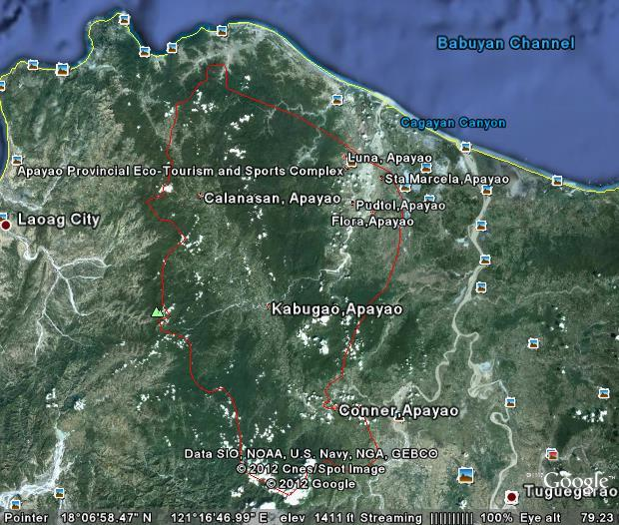
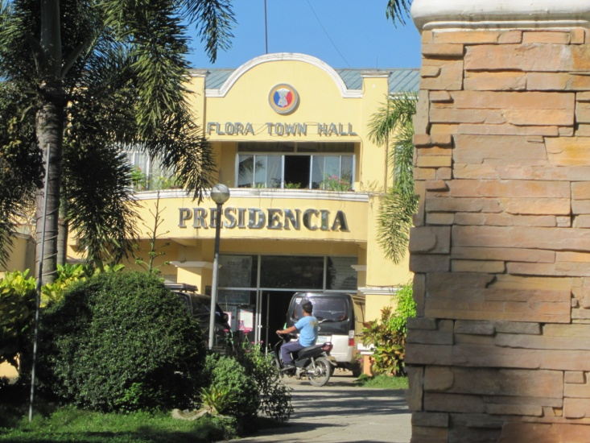
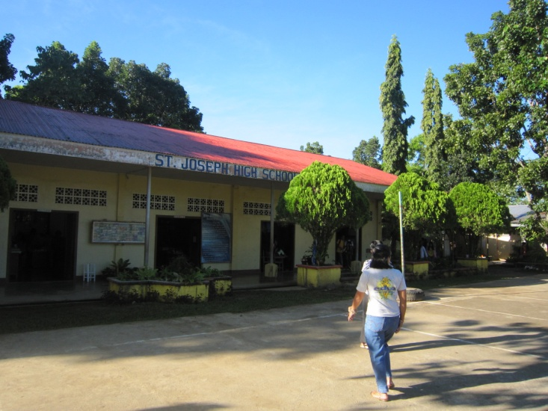
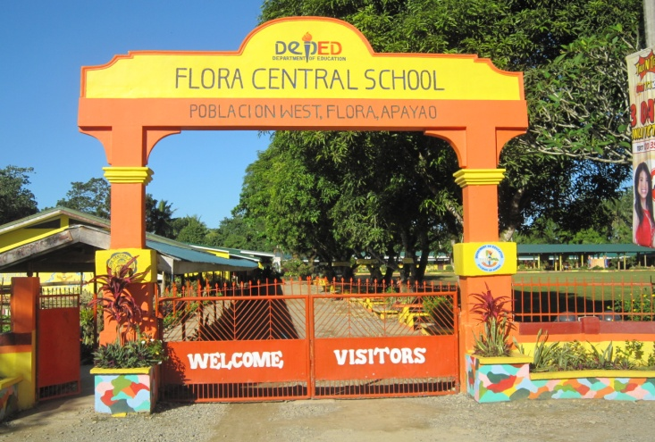
MUNICIPALITY OF FLORA
FLORA TOWN HALL
DR. EFREN U.DE SAN JOSE SPORTS CENTER
SAINT JOSEPH HIGH SCHOOL
FLORA CENTRAL SCHOOL

Slide 21
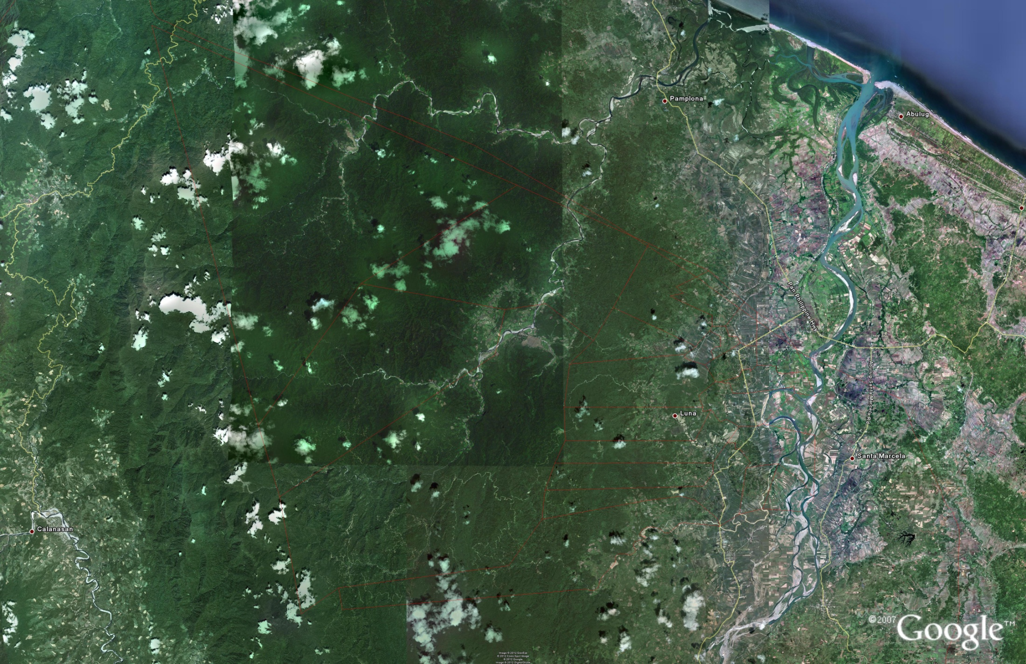
ROAD NETWORK FROM FLORA TO APETSC
APAYAO-CAGAYAN BOUNDARY
JCT. TO FLORA AYAGA,LUCBAN, ABULOG,CAGAYAN
JCT. TO LUNA,LIBERTAD,ABULOG,CAGAYAN
LUNA,APAYAO
APAYAO PROVINCIAL ECO-TOURISM AND SPORTS COMPLEX
FLORA,APAYAO

Slide 22
60
DISTANCE FROM FLORA TO PLAYING VENUES
EVENT | VENUE | DISTANCE (Kms.) | TIME Mins.
ARCHERY | APETSC | 32 | 45
ARNIS | PUDTOL GYM (OLD) | 45 | 60
ATHLETICS | APETSC | 32 | 45
BADMINTON | FLORA GYM | 0.300 | 2
BASEBALL | APETSC | 32 | 45
BASKETBALL (ELEM.) | STA MARCELA GYM | 7.5 | 10
BASKETBALL | BVMSC AND APETSC | 30 AND 32 | 40 & 45

Slide 23
EVENT | VENUE | DISTANCE (Kms.) | TIME Mins.
BOXING | LAND BANK OPEN GROUND LUNA | 27.5 | 38
CHESS | CLUB HOUSE | 32 | 45
FOOTBALL SOCCER | APETSC | 32 | 45
GYMNASTICS | SAN ISIDRO GYM LUNA | 25.5 | 35
SIPA/SEPAK TAKRAW | APETSC | 32 | 45
SOFTBALL | APETSC | 32 | 45
SWIMMING | APETSC | 32 | 45

Slide 24
EVENT | VENUE | DISTANCE (Kms.) | TIME (Mins.)
TABLE TENNIS | NFA-TUMOG LUNA | 26 | 37
TAEKWONDO | PUDTOL GYM (NEW) | 45 | 60
LAWN TENNIS (ELEM.) | PUDTOL CENTRAL SCHOOL | 45 | 60
LAWN TENNIS | APETSC | 32 | 45
VOLLEYBALL | APETSC | 32 | 45

Slide 25
HOST MUNICIPALITY: LUNA
HOST SCHOOLS: LUNA CENTRAL SCHOOL
LUNA NATIONAL HIGH SCHOOL (MAIN)
DELEGATION: BAGUIO CITY

Slide 26
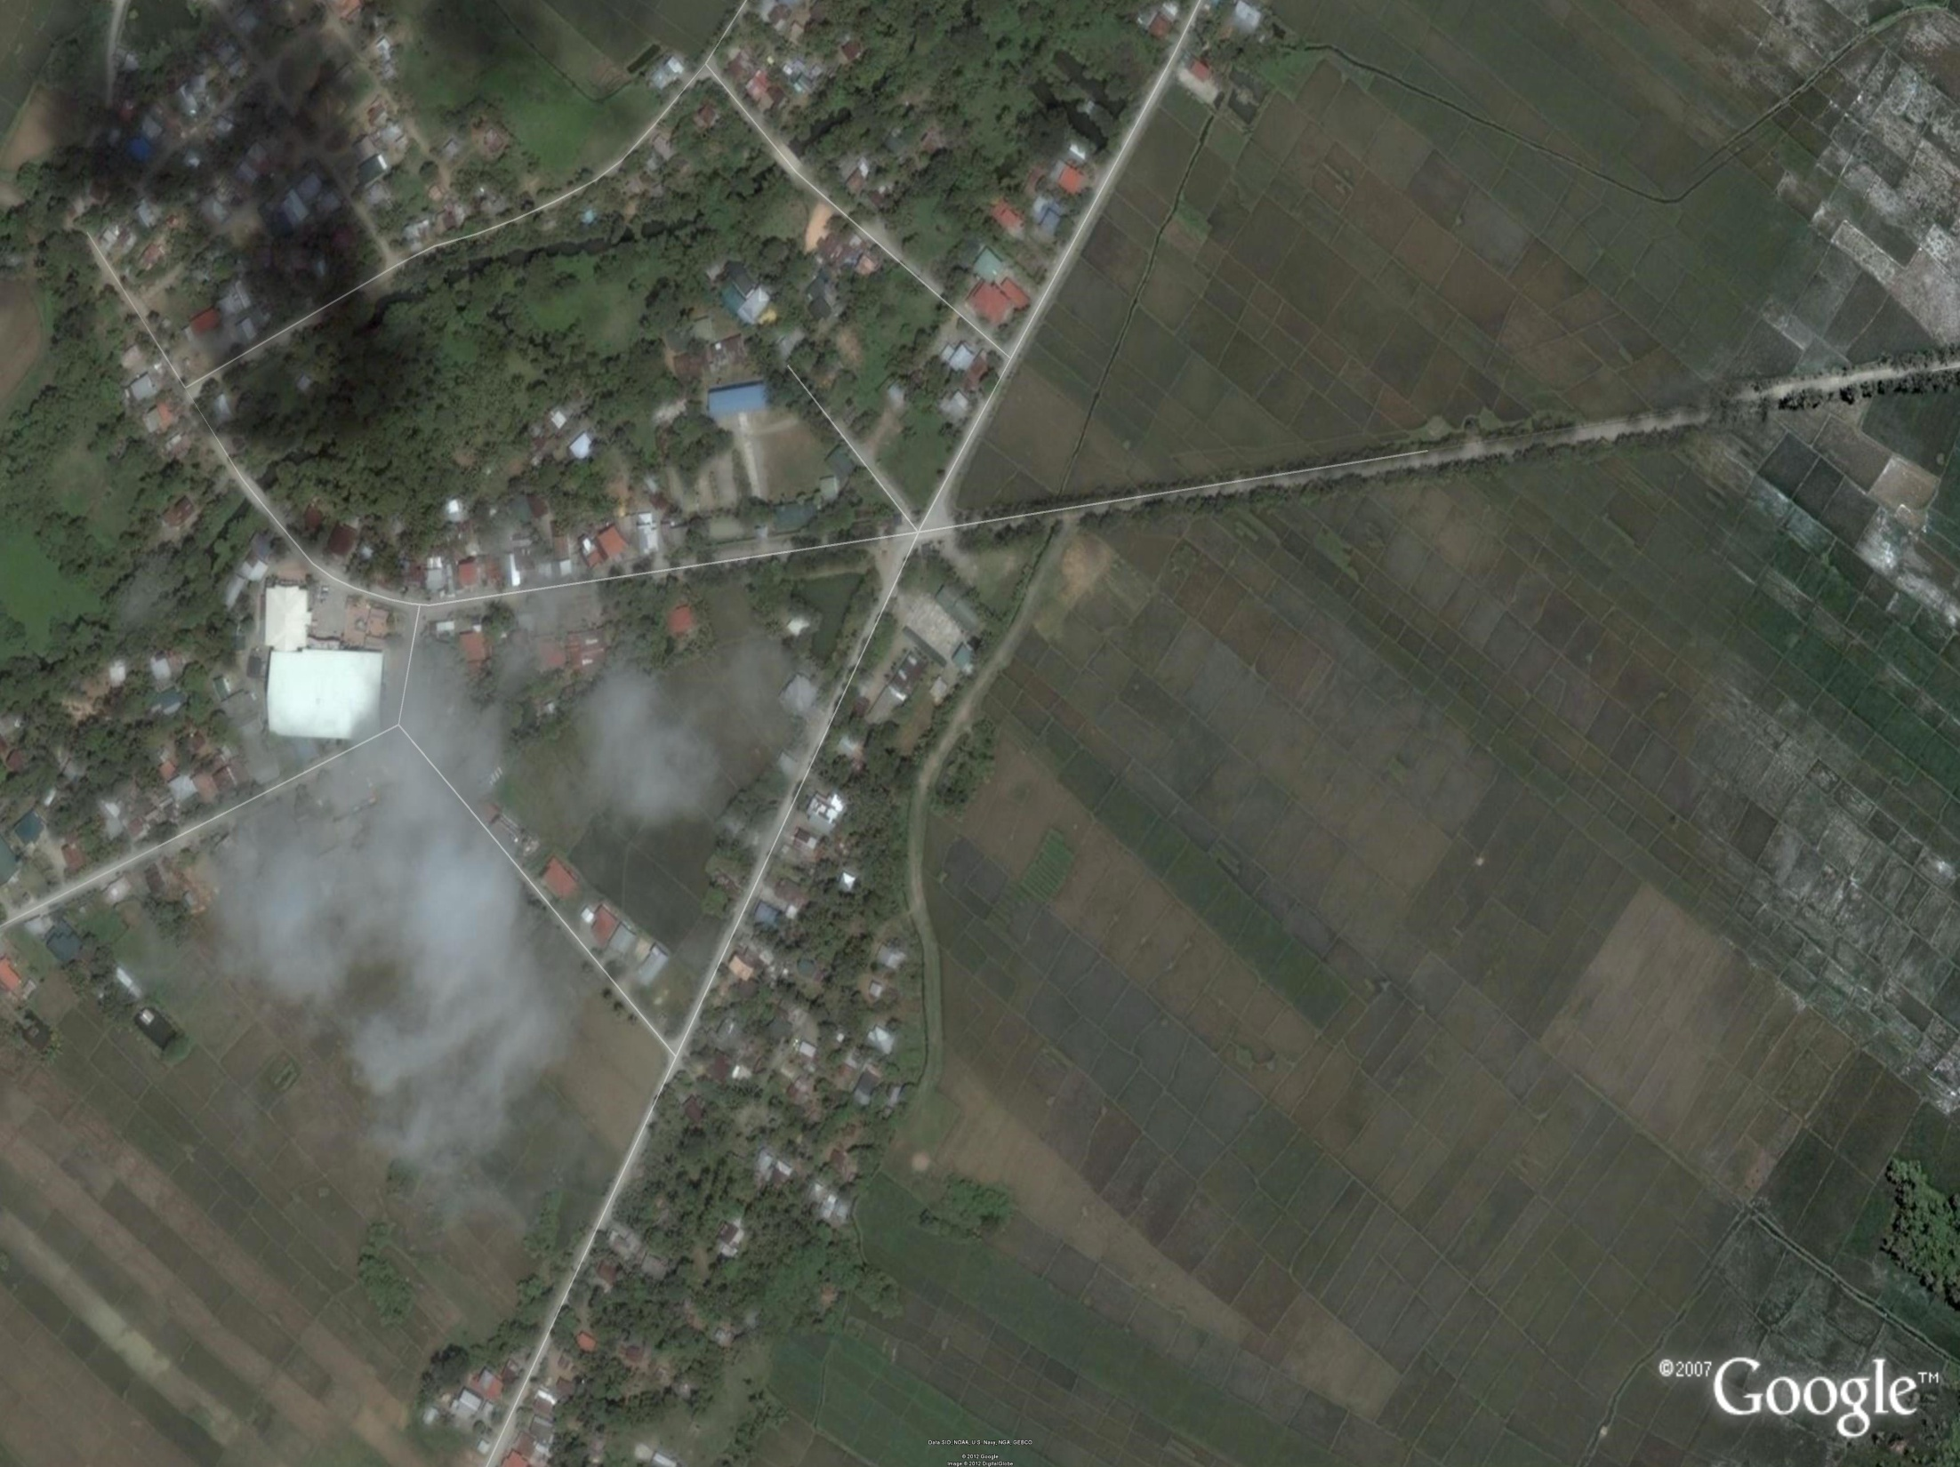
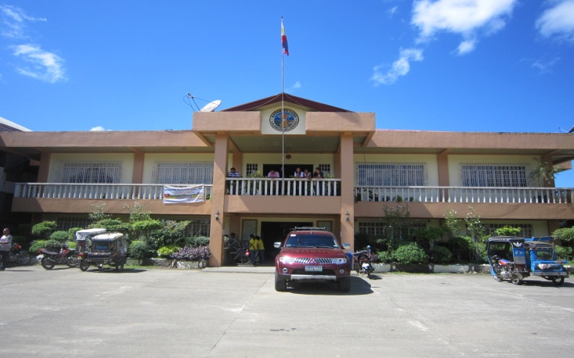
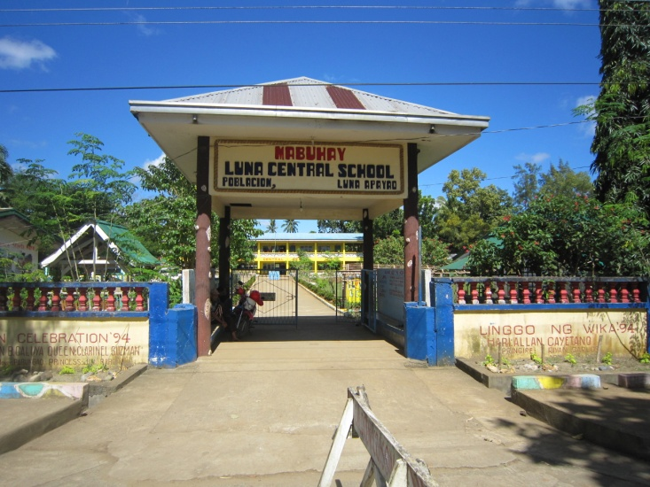
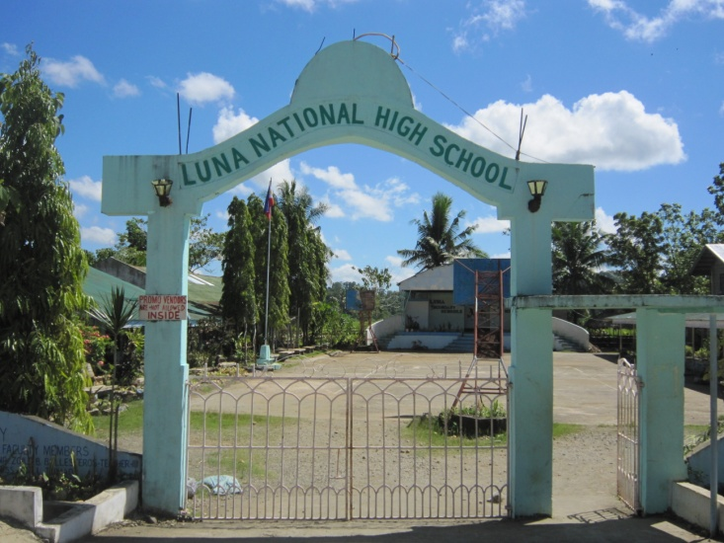
LUNA CENTRAL SCHOOL
MUNICIPALITY OF LUNA
LUNA TOWN HALL
LUNA NATIONAL HIGH SCHOOL
BIENVENIDO VERZOLA JR. MEMORIAL SPORTS CENTER

Slide 27
60
DISTANCE FROM LUNA CENTRAL SCHOOL TO PLAYING VENUES
EVENT | VENUE | DISTANCE (Kms.) | TIME Mins.
ARCHERY | APETSC | 2 | 5
ARNIS | PUDTOL GYM (OLD) | 18 | 20
ATHLETICS | APETSC | 2 | 5
BADMINTON | FLORA GYM | 27 | 38
BASEBALL | APETSC | 2 | 5
BASKETBALL (ELEM.) | STA MARCELA GYM | 19.5 | 22
BASKETBALL | BVMSC AND APETSC | 0.100 & 2 | 1 AND 5

Slide 28
EVENT | VENUE | DISTANCE (Kms.) | TIME Mins.
BOXING | LAND BANK OPEN GROUND LUNA | 0.120 | 1
CHESS | CLUB HOUSE | 2 | 5
FOOTBALL SOCCER | APETSC | 2 | 5
GYMNASTICS | SAN ISIDRO GYM LUNA | 2 | 3
SIPA/SEPAK TAKRAW | APETSC | 2 | 5
SOFTBALL | APETSC | 2 | 5
SWIMMING | APETSC | 2 | 5

Slide 29
EVENT | VENUE | DISTANCE (Kms.) | TIME (Mins.)
TABLE TENNIS | NFA-TUMOG LUNA | 2.5 | 4
TAEKWONDO | PUDTOL GYM (NEW) | 18 | 20
LAWN TENNIS (ELEM.) | PUDTOL CENTRAL SCHOOL | 18 | 20
LAWN TENNIS | APETSC | 2 | 5
VOLLEYBALL | APETSC | 2 | 5

Slide 30
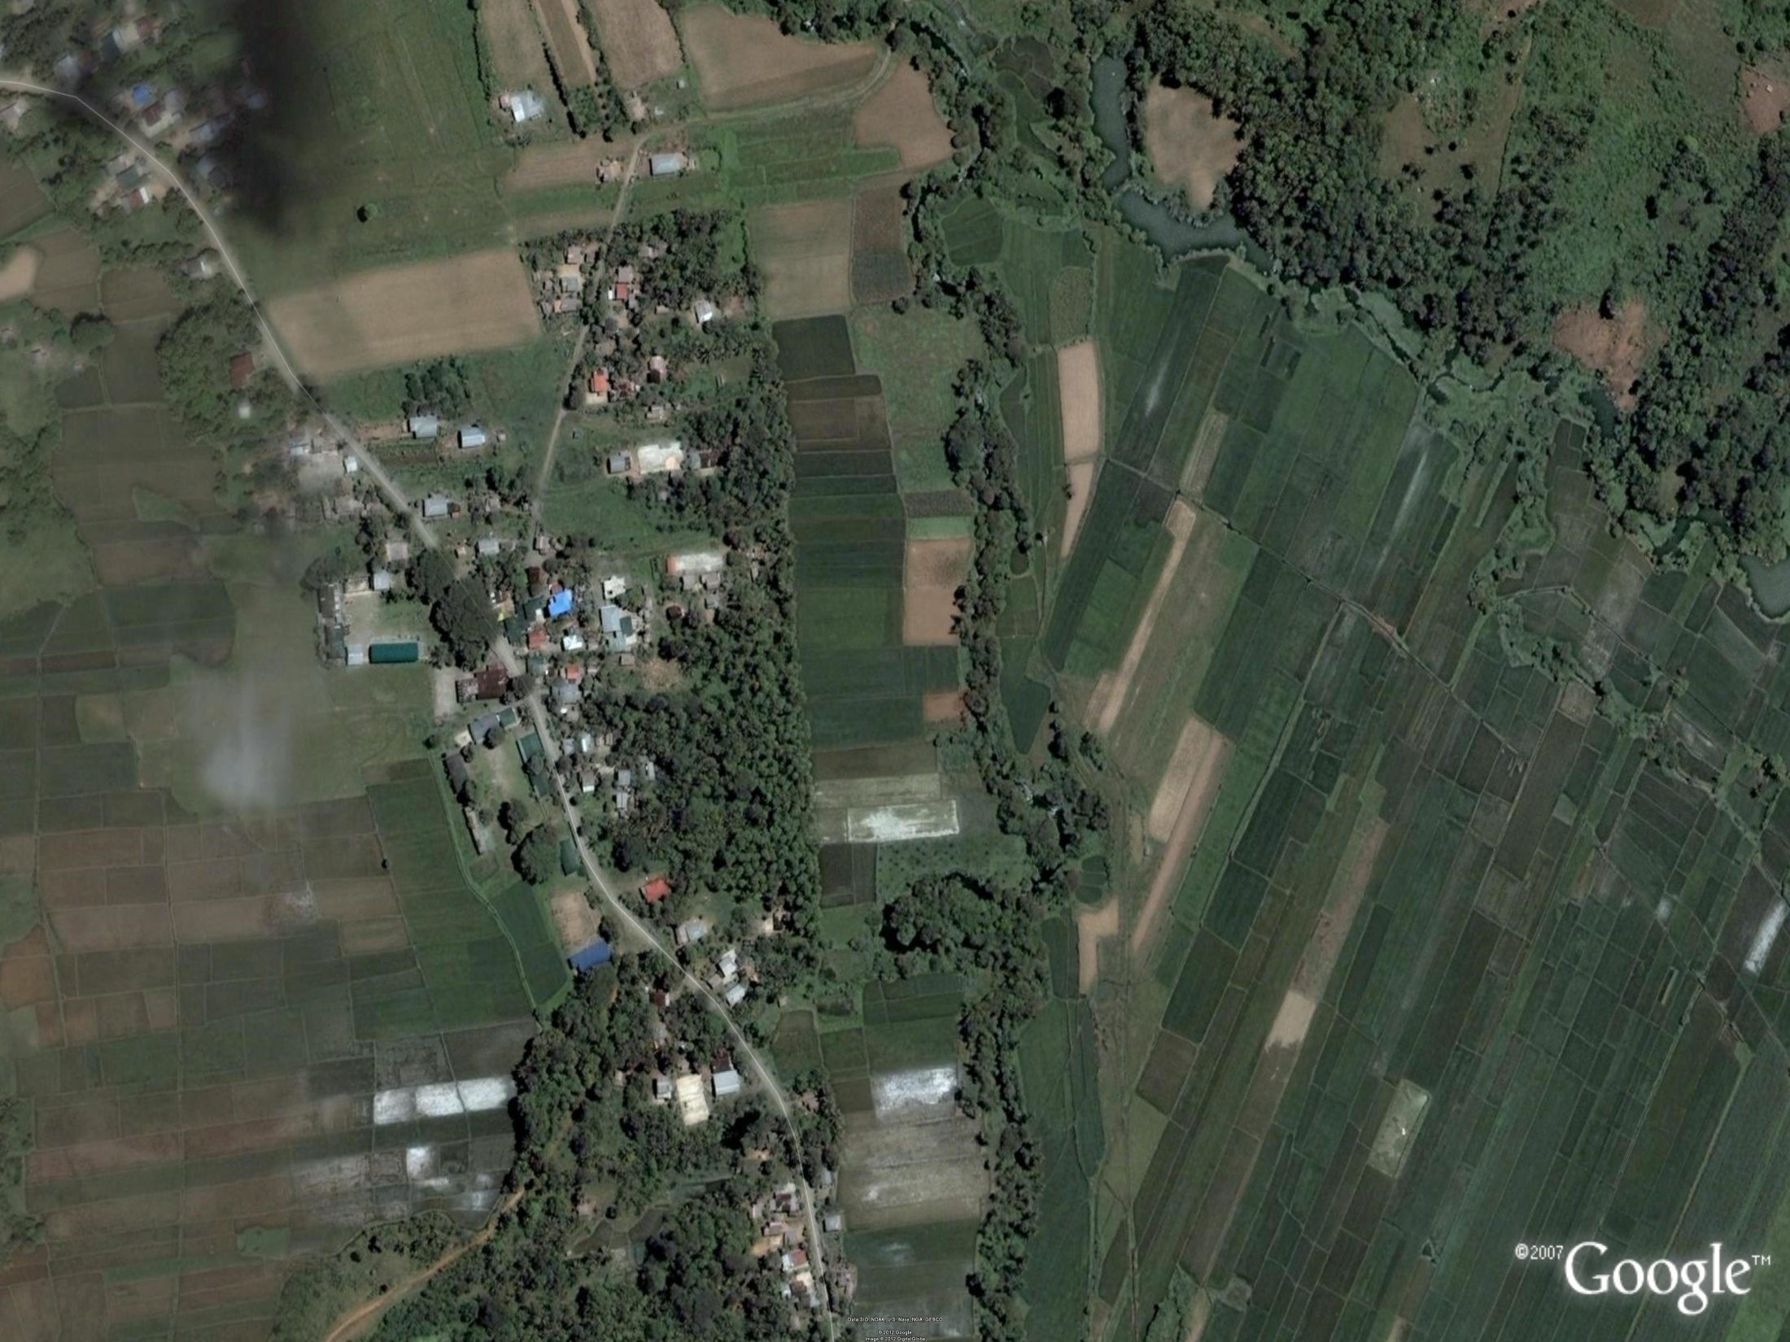
9
HOST MUNICIPALITY: LUNA
HOST SCHOOLS: BacDa NATIONAL HIGH SCHOOL
BACSAY ELEMENTARY SCHOOL
DELEGATION: IFUGAO PROVINCE

Slide 31
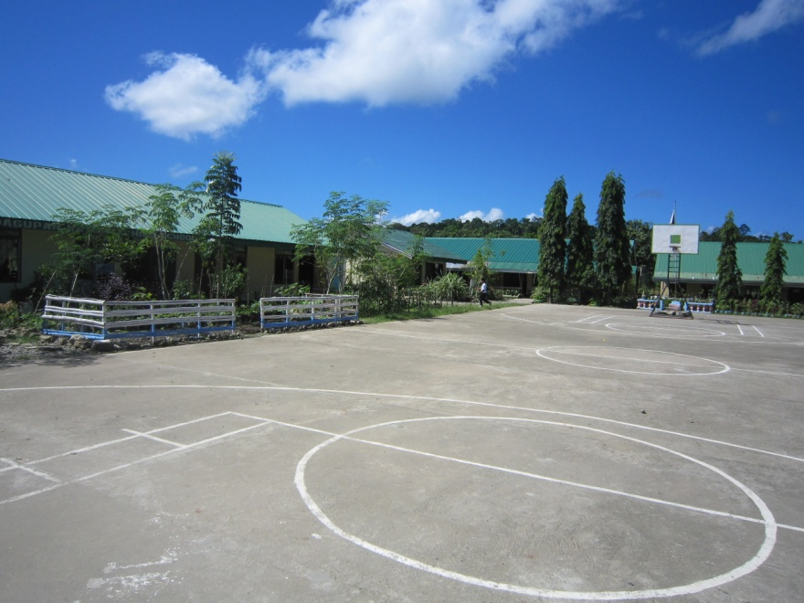
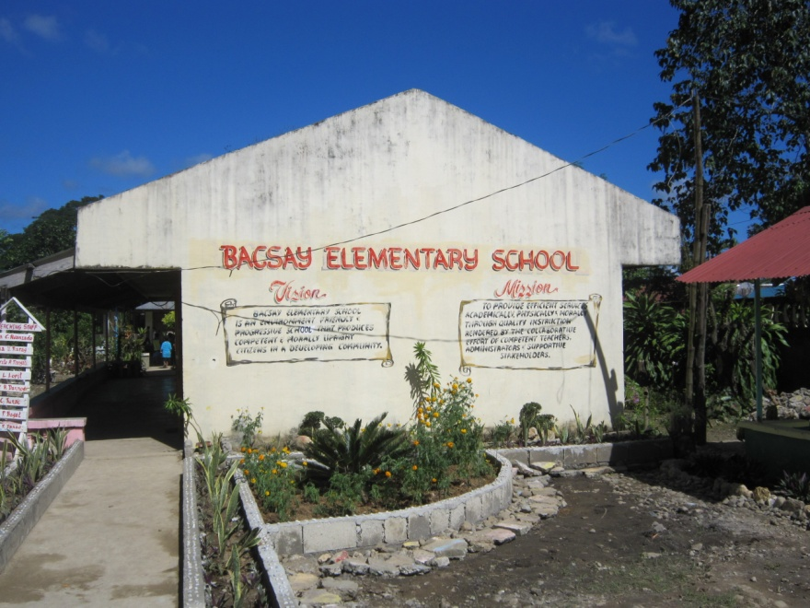
MUNICIPALITY OF LUNA
BacDA NATIONAL HIGH SCHOOL
BACSAY ELEMENTARY SCHOOL

Slide 32
60
DISTANCE FROM BACDA NAT’L HIGH SCHOOL TO PLAYING VENUES
EVENT | VENUE | DISTANCE (Kms.) | TIME Mins.
ARCHERY | APETSC | 3 | 7
ARNIS | PUDTOL GYM (OLD) | 8 | 15
ATHLETICS | APETSC | 3 | 7
BADMINTON | FLORA GYM | 33 | 45
BASEBALL | APETSC | 3 | 7
BASKETBALL (ELEM.) | STA MARCELA GYM | 26 | 35
BASKETBALL | BVMSC AND APETSC | 5 & 3 | 12 AND 7

Slide 33
EVENT | VENUE | DISTANCE (Kms.) | TIME Mins.
BOXING | LAND BANK OPEN GROUND LUNA | 5 | 12
CHESS | CLUB HOUSE | 3 | 7
FOOTBALL SOCCER | APETSC | 3 | 7
GYMNASTICS | SAN ISIDRO GYM LUNA | 7 | 15
SIPA/SEPAK TAKRAW | APETSC | 3 | 7
SOFTBALL | APETSC | 3 | 7
SWIMMING | APETSC | 3 | 7

Slide 34
EVENT | VENUE | DISTANCE (Kms.) | TIME (Mins.)
TABLE TENNIS | NFA-TUMOG LUNA | 7.5 | 18
TAEKWONDO | PUDTOL GYM (NEW) | 8 | 15
LAWN TENNIS (ELEM.) | PUDTOL CENTRAL SCHOOL | 8 | 15
LAWN TENNIS | APETSC | 3 | 7
VOLLEYBALL | APETSC | 3 | 7

Slide 35
HOST MUNICIPALITY: LUNA
HOST SCHOOLS: TUMOG ELEMENTARY SCHOOL
LUNA NATIONAL HIGH SCHOOL ANNEX
STA LINA ELEMENTARY SCHOOL
DELEGATION: MT. PROVINCE

Slide 36
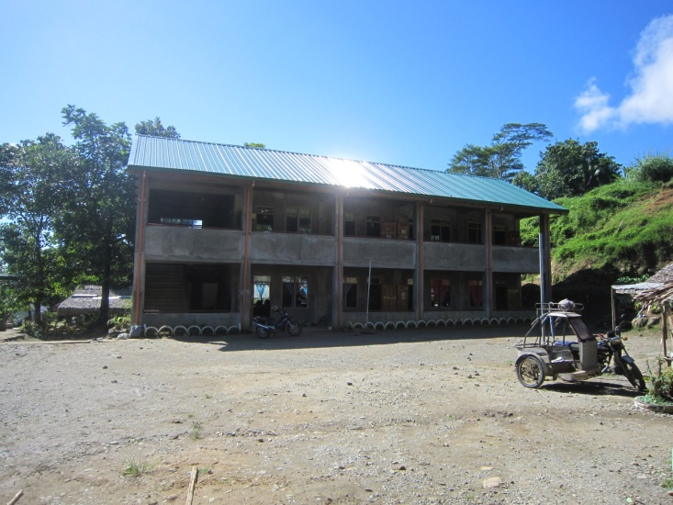
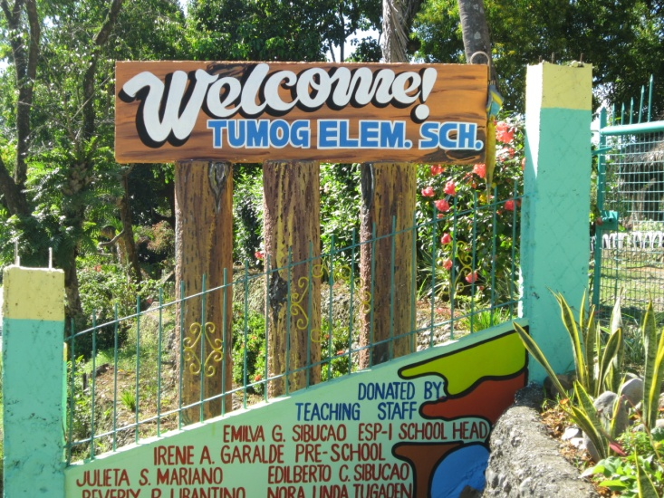
MUNICIPALITY OF LUNA
NFA-TUMOG
LUNA NATIONAL HIGH SCHOOL (ANNEX)
TUMOG ELEMENTARY SCHOOL

Slide 37
60
DISTANCE FROM TUMOG ELEMENTARY SCHOOL TO PLAYING VENUES
EVENT | VENUE | DISTANCE (Kms.) | TIME Mins.
ARCHERY | APETSC | 4.7 | 12
ARNIS | PUDTOL GYM (OLD) | 16 | 18
ATHLETICS | APETSC | 4.7 | 12
BADMINTON | FLORA GYM | 26 | 40
BASEBALL | APETSC | 4.7 | 12
BASKETBALL (ELEM.) | STA MARCELA GYM | 17 | 30
BASKETBALL | BVMSC AND APETSC | 3 & 4.7 | 5 AND 12

Slide 38
EVENT | VENUE | DISTANCE (Kms.) | TIME Mins.
BOXING | LAND BANK OPEN GROUND LUNA | 3 | 5
CHESS | CLUB HOUSE | 4.7 | 12
FOOTBALL SOCCER | APETSC | 4.7 | 12
GYMNASTICS | SAN ISIDRO GYM LUNA | 0.7 | 3
SIPA/SEPAK TAKRAW | APETSC | 4.7 | 12
SOFTBALL | APETSC | 4.7 | 12
SWIMMING | APETSC | 4.7 | 12

Slide 39
EVENT | VENUE | DISTANCE (Kms.) | TIME (Mins.)
TABLE TENNIS | NFA-TUMOG LUNA | 0.2 | 2
TAEKWONDO | PUDTOL GYM (NEW) | 16 | 18
LAWN TENNIS (ELEM.) | PUDTOL CENTRAL SCHOOL | 16 | 18
LAWN TENNIS | APETSC | 4.7 | 12
VOLLEYBALL | APETSC | 4.7 | 12

Slide 40
HOST MUNICIPALITY: PUDTOL
HOST SCHOOLS: PUDTOL CENTRAL SCHOOL
SANTO ROSARIO HIGH SCHOOL
DELEGATION: BENGUET PROVINCE

Slide 41
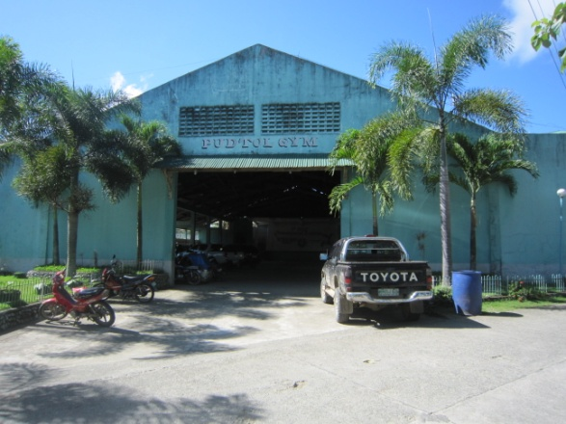
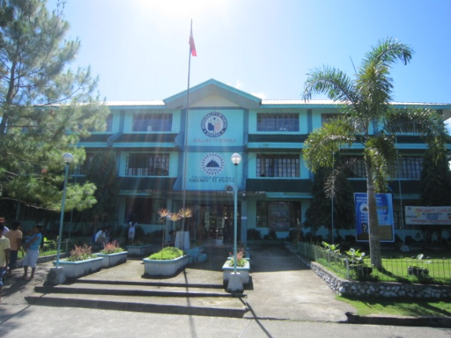
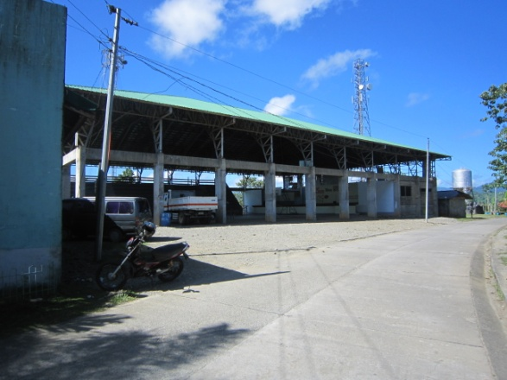
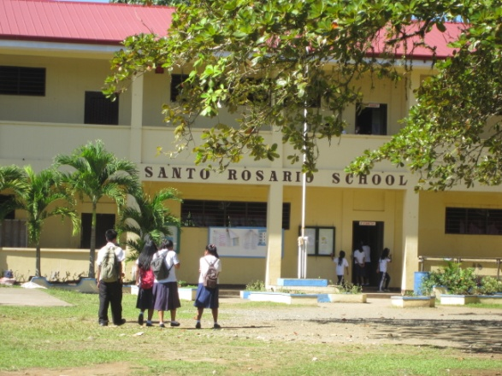
MUNICIPALITY OF PUDTOL
PUDTOL CENTRAL SCHOOL
PUDTOL GYM (OLD)
PUDTOL TOWN HALL
PUDTOL GYM (NEW)
SANTO ROSARIO SCHOOL

Slide 42
ROAD NETWORK FROM PUDTOL TO APETSC
APAYAO-CAGAYAN BOUNDARY
LUNA,APAYAO
APAYAO PROVINCIAL ECO-TOURISM AND SPORTS COMPLEX
KABUGAO-PUDTOL-LUNA-CAGAYAN BOUNDARY ROAD
ALTERNATE ROUTE PUDTOL BACSAY ROAD
PUDTOL,APAYAO

Slide 43
60
DISTANCE FROM PUDTOL CENTRAL SCHOOL TO PLAYING VENUES
EVENT | VENUE | DISTANCE (Kms.) | TIME Mins.
ARCHERY | APETSC | 20 | 25
ARNIS | PUDTOL GYM (OLD) | 0.3 | 3
ATHLETICS | APETSC | 20 | 25
BADMINTON | FLORA GYM | 45 | 60
BASEBALL | APETSC | 20 | 25
BASKETBALL (ELEM.) | STA MARCELA GYM | 37.5 | 50
BASKETBALL | BVMSC AND APETSC | 18 & 20 | 20 AND 25

Slide 44
EVENT | VENUE | DISTANCE (Kms.) | TIME Mins.
BOXING | LAND BANK OPEN GROUND LUNA | 18 | 20
CHESS | CLUB HOUSE | 20 | 25
FOOTBALL SOCCER | APETSC | 20 | 25
GYMNASTICS | SAN ISIDRO GYM LUNA | 16 | 18
SIPA/SEPAK TAKRAW | APETSC | 20 | 25
SOFTBALL | APETSC | 20 | 25
SWIMMING | APETSC | 20 | 25

Slide 45
EVENT | VENUE | DISTANCE (Kms.) | TIME (Mins.)
TABLE TENNIS | NFA-TUMOG LUNA | 15.5 | 17
TAEKWONDO | PUDTOL GYM (NEW) | 0.3 | 3
LAWN TENNIS (ELEM.) | PUDTOL CENTRAL SCHOOL | - | -
LAWN TENNIS | APETSC | 20 | 25
VOLLEYBALL | APETSC | 20 | 25

Slide 46
HOST MUNICIPALITY: STA MARCELA
HOST SCHOOLS: STA MARCELA NATIONAL HIGH SCHOOL
STA MARCELA WEST CENTRAL ELEMENTARY SCHOOL
DELEGATION: APAYAO PROVINCE

Slide 47
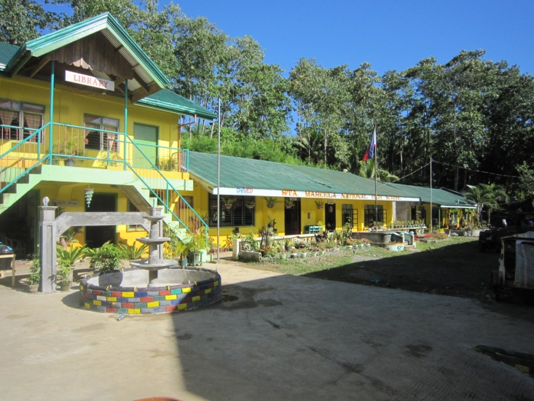
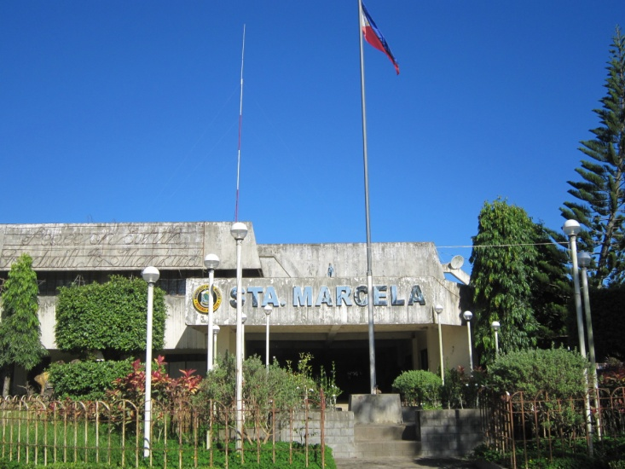
STA MARCELA NATIONAL HIGH SCHOOL
MUNICIPALITY OF STA MARCELA
STA MARCELA WEST CENTRAL ELEMENTARY SCHOOL
STA MARCELA MUNICIPAL HALL
STA MARCELA GYMNASIUM

Slide 48
ROAD NETWORK FROM STA MARCELA TO APETSC
APAYAO-CAGAYAN BOUNDARY
JCT. TO FLORA AYAGA,LUCBAN, ABULOG,CAGAYAN
JCT. TO LUNA LIBERTAD,ABULOG,CAGAYAN
LUNA,APAYAO
APAYAO PROVINCIAL ECO-TOURISM AND SPORTS COMPLEX
STA MARCELA,APAYAO

Slide 49
60
DISTANCE FROM STA MARCELA NAT’L. SCHOOL TO PLAYING VENUES
EVENT | VENUE | DISTANCE (Kms.) | TIME Mins.
ARCHERY | APETSC | 22 | 30
ARNIS | PUDTOL GYM (OLD) | 37.5 | 50
ATHLETICS | APETSC | 22 | 30
BADMINTON | FLORA GYM | 7.5 | 10
BASEBALL | APETSC | 22 | 30
BASKETBALL (ELEM.) | STA MARCELA GYM | 0.2 | 3
BASKETBALL | BVMSC AND APETSC | 20 & 22 | 25 AND 30

Slide 50
EVENT | VENUE | DISTANCE (Kms.) | TIME Mins.
BOXING | LAND BANK OPEN GROUND LUNA | 20 | 25
CHESS | CLUB HOUSE | 22 | 30
FOOTBALL SOCCER | APETSC | 22 | 30
GYMNASTICS | SAN ISIDRO GYM LUNA | 18 | 22
SIPA/SEPAK TAKRAW | APETSC | 22 | 30
SOFTBALL | APETSC | 22 | 30
SWIMMING | APETSC | 22 | 30

Slide 51
EVENT | VENUE | DISTANCE (Kms.) | TIME (Mins.)
TABLE TENNIS | NFA-TUMOG LUNA | 18.5 | 23
TAEKWONDO | PUDTOL GYM (NEW) | 37.5 | 50
LAWN TENNIS (ELEM.) | PUDTOL CENTRAL SCHOOL | 37.5 | 50
LAWN TENNIS | APETSC | 22 | 30
VOLLEYBALL | APETSC | 22 | 30

Slide 52
HOST MUNICIPALITY: STA MARCELA
HOST SCHOOLS: SIPA IMELDA NATIONAL HIGH SCHOOL
SIPA ELEMENTARY SCHOOL
DELEGATION: ABRA PROVINCE

Slide 53
MUNICIPALITY OF STA MARCELA
SIPA ELEMENTARY SCHOOL
SIPA-IMELDA NATIONAL HIGH SCHOOL

Slide 54
60
DISTANCE FROM SIPA ELEMENTARY SCHOOL TO PLAYING VENUES
EVENT | VENUE | DISTANCE (Kms.) | TIME Mins.
ARCHERY | APETSC | 28 | 40
ARNIS | PUDTOL GYM (OLD) | 41 | 53
ATHLETICS | APETSC | 28 | 40
BADMINTON | FLORA GYM | 4 | 6
BASEBALL | APETSC | 28 | 40
BASKETBALL (ELEM.) | STA MARCELA GYM | 4 | 6
BASKETBALL | BVMSC AND APETSC | 26 & 28 | 35 AND 40

Slide 55
EVENT | VENUE | DISTANCE (Kms.) | TIME Mins.
BOXING | LAND BANK OPEN GROUND LUNA | 26 | 35
CHESS | CLUB HOUSE | 28 | 40
FOOTBALL SOCCER | APETSC | 28 | 40
GYMNASTICS | SAN ISIDRO GYM LUNA | 24 | 33
SIPA/SEPAK TAKRAW | APETSC | 28 | 40
SOFTBALL | APETSC | 28 | 40
SWIMMING | APETSC | 28 | 40

Slide 56
EVENT | VENUE | DISTANCE (Kms.) | TIME (Mins.)
TABLE TENNIS | NFA-TUMOG LUNA | 24.5 | 35
TAEKWONDO | PUDTOL GYM (NEW) | 41 | 53
LAWN TENNIS (ELEM.) | PUDTOL CENTRAL SCHOOL | 41 | 53
LAWN TENNIS | APETSC | 28 | 40
VOLLEYBALL | APETSC | 28 | 40

Slide 57
HOST MUNICIPALITY: LUNA
HOST SCHOOLS: APAYAO STATE COLLEGE
APAYAO SCIENCE HIGH SCHOOL
QUIRINO ELEMENTARY SCHOOL
SAN ISIDRO ELEMENTARY SCHOOL
DELEGATION
OFFICIATING OFFICIALS

Slide 58
HOST MUNICIPALITY: LUNA
HOST: DIVISION OFFICE
DELEGATION
REGIONAL PERSONNEL AND
SCREENING COMMITTEE

Slide 59
THANK YOU
SEE YOU IN 2013

