Slide 1
The What, Why and How of Mother Tongue-Based Multilingual Education
(MTB-MLE)

Slide 2
THE
WHAT

Slide 3
WHAT IS
MULTILINGUAL EDUCATION
Mother tongue-based multilingual education (MLE) is education, formal or non - formal, in which the learner’s mother tongue and additional languages are used in the classroom. Learners begin their education in the language they understand best - their mother tongue - and develop a strong foundation in their mother language before adding additional languages.

Slide 4
MULTILINGUAL EDUCATION
|The purpose of a multilingual
education program is to develop appropriate cognitive and reasoning skills enabling children to operate equally in different languages - starting in the mother tongue.

Slide 5
MULTILINGUAL EDUCATION
| is a structured program of language learning and cognitive development providing
{ a strong educational foundation in the first language { successful bridging to one or more additional languages
{ enabling the use of both/all languages for life-long learning
| is based in the child’s own known environment and bridges to the
wider world. “Known to Unknown”

Slide 6
MULTILINGUAL EDUCATION
|maintains local language and culture while providing
national/international language acquisition and instruction
|promotes learners’ integration into the national society without forcing them to sacrifice their linguistic and cultural heritage.

Slide 7
MULTILINGUAL EDUCATION
|Meaning based education enables
students to learn well because they understand what the teacher is saying.
|Using the culture the child knows enables immediate comprehension from which new concepts can be built - going from the known to the unknown.

Slide 8
MULTILINGUAL EDUCATION
|Reading in the mother
tongue enables immediate comprehension
|Once we learn to read we never have to learn again -
“We only learn to READ once”

Slide 9
THE
WHYS

Slide 10
WHERE WE ARE NOW
Insufficient mastery of basic competencies due to congested curriculum
High school graduates (< 18 years) lack basic competencies and
maturity
Other countries view the 10‐year education cycle as insufficient.

Slide 11
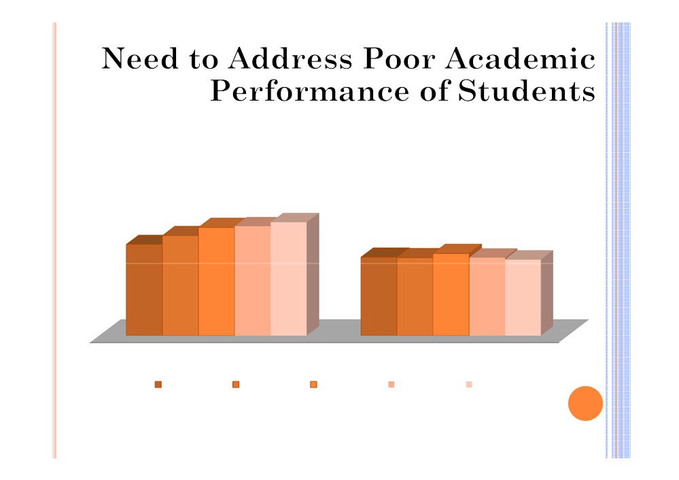
Trend in National Achievement Test (NAT) in Mean
Percentage Score for School Years 2005-2007 to 2009-2010 in Elementary and Secondary Levels
65.6
68.0
59.9
64.8
54.7
47.0
49.3
46.7 45.6
46.7
Elementary
Secondary
2005-2006
2006-2007
2007-2008
2008-2009
2009-2010
The NAT results showed low academic performance of the students in the core subjects: English, Filipino, Mathematics, Sciences and Social Studies.
11

Slide 12
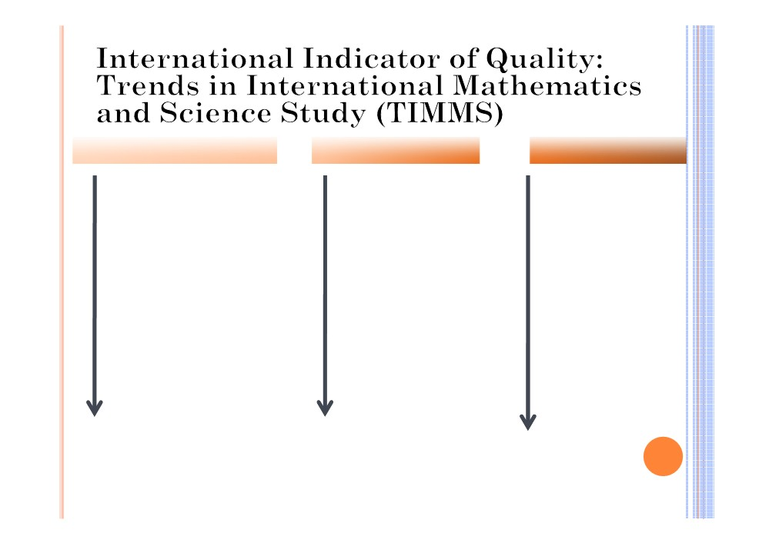
Grade IV Math and Science
High School Math
High School Science
1 Top 2
1 Top 2
1 Top 2
3
3
3
21
34
42
22
Philippines
43
23
35
Philippines
Philippines
36
44
24
37
45
The poor performance in the 2003 TIMSS reflects low quality of Science and Mathematics m
Education in the elementary and secondary levels.

Slide 13
WHAT DO
WE KNOW ALREADY

Slide 14
WE KNOW THAT…
1. The most important single factor influencing learning is what the learners already know. Ascertain this and teach them accordingly
(Ausubel, D. P. 1968. Page 235)…

Slide 15
WE KNOW THAT…
2. It takes children about 12 years to gain the level of proficiency in their L1 that will enable them to continue developing that language for the rest of their lives;

Slide 16
We know that…
3. IT TAKES CHILDREN (AND ADULTS) AT LEAST 2 YEARS TO GAIN THE BASIC LEVEL OF PROFICIENCY IN A NEW LANGUAGE THAT WILL ENABLE THEM TO USE IT FOR ‘EVERYDAY’ COMMUNICATION; AND IF THEY DO NOT HEAR THE L2 OUTSIDE THE CLASSROOM, IT TAKES MUCH LONGER.

Slide 17
WE ALSO KNOW THAT…
4. It takes them 5-7 years to develop a level of academic proficiency in the new language that will enable them to use it to learn abstract concepts, and if they don’t have good “L1-L2-L1” teaching, they will not ever gain
academic proficiency.

Slide 18
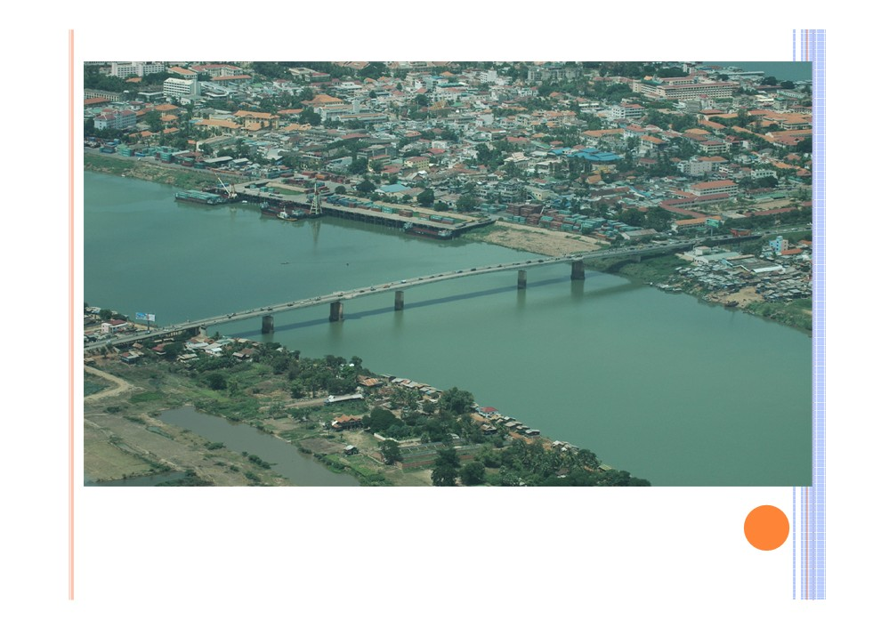
Photo:
Ari Vitikainen
And that is why we emphasize a strong foundation - the good bridge!

Slide 19
BUT DEPED CAN’T DO THIS ALONE
“It Takes
a Village to Raise a Child”

Slide 20
Vision:
Relevant and Quality
Education for All.
Desired Impact:
Learners are enjoying relevant and quality education which support their home languages and cultures; Learning
outcomes are improved country-wide; and the
Philippine is succeeding in its goal for Education For ALL.

Slide 21
STATEMENT FROM PRES. NOYNOY AQUINO…
“My view on this is larger than just the classroom. We should become tri-lingual as a country; ¾ Learn English well and
connect to the world.
¾ Learn Filipino well and connect to our country.
¾ Retain your mother tongue and connect to your
heritage."

Slide 22
LEGAL BASES
DepED Order No. 74, s. 2009
“Institutionalizing Mother Tongue-Based Multilingual Education (MTB-MLE)”
1987 Constitution (Article XIV Sec 7) RA 8980 ECCD Law (Sec 5a) EFA/MDG Goals
BESRA KRT 3

Slide 23
Four Aspects of Development
Language Development
Cognitive
Development
Socio-Cultural Development

Slide 24
1. Language development:
 Students will establish a strong
educational foundation in the language they know best;
 they will build a good “bridge” to the school language(s), and
 they will be prepared to use both / all of their languages for success in school and for life-long learning.

Slide 25
2. Cognitive Development
Cognitive development begins at home at birth.
School activities will engage learners to move well beyond the basic questions of who, what, when and where to cover all higher order thinking skills in the learners L1, their language of thought.
These higher order thinking skills will:
- transfer to the other languages once enough Filipino or English has been acquired to use these skills in thinking and articulating thought, and
- be used in the process of acquiring English and Filipino more effectively

Slide 26
3. ACADEMIC DEVELOPMENT:
 Students will achieve government competencies in each subject area and, at the end of the program;
 they will be prepared to enter and achieve well in the mainstream education system.

Slide 27
4. SOCIAL-CULTURAL DEVELOPMENT:
 Students will be proud of their
heritage language and culture, and respect the languages and cultures of others;
 they will be prepared to contribute productively to their own community and to the larger society.

Slide 28
THE END RESULT: CHILDREN WHO ARE …
Multilingual
Multi-literate
Multi-cultural

Slide 29
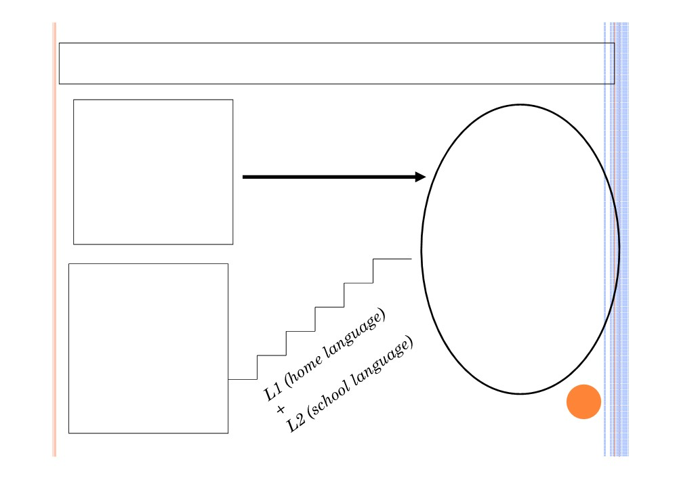
Same competencies but different paths
Mainstream
children who speak the
L1 (school language)
school
Competencies to be achieved by the end of Grade 3
language
Mainstream children who do NOT
speak the school
language

Slide 30
INITIATIVES IN MLE
A. Experiments:
a. First Iloilo Experiment (1948-1954) : Hiligaynon as MOI in Grades 1 & II
b. Second Iloilo Language Experiment (1961- 1964) Hiligaynon is used in first two grades
c. Rizal Experiment (1960 - 1966) Tagalog as MOI in Grade I
d. First Language Component-Bridging Program (FLC-BP) on “transitional” education (1986 - 1993)
Children’s L1 in Grades I & 2 and transition to Filipino and English

Slide 31
B. THE LINGUA FRANCA
EDUCATION (LFE) PILOT STUDY - 1999-2002
y Define and implement national bridging program from mother tongue to Filipino and English to develop initial literacy
y Use 4 of largest lingua francas as MOI in grades 1 and 2:Tagalog, Hiligaynon, Cebuano and Ilocano
y Attempt to bridge learned concept from MT to Filipino and English

Slide 32
C. LUBUAGAN KALINGA MLE PROGRAM
y Implemented by Summer Institute of Linguistics for 10 years
y 3 experimental classes implementing MTB-MLE approach
y 3 control classes using traditional
method of immersion in English and Filipino
y Schools are of same SES (Social Economic Status)

Slide 33
RESULTS OF DIFFERENT INITIATIVES
| Children who began school in first language with bridging to two second languages
§ were significantly more competent in all areas of study than their counterparts
§ outperformed English-taught students in reading, math and social studies
§ learn to read more quickly and learn better in Math and Science
§ were observed to be actively participating in different classroom activities
o Drop-out and repetition rates decreased

Slide 34
HE
HOWS

Slide 35
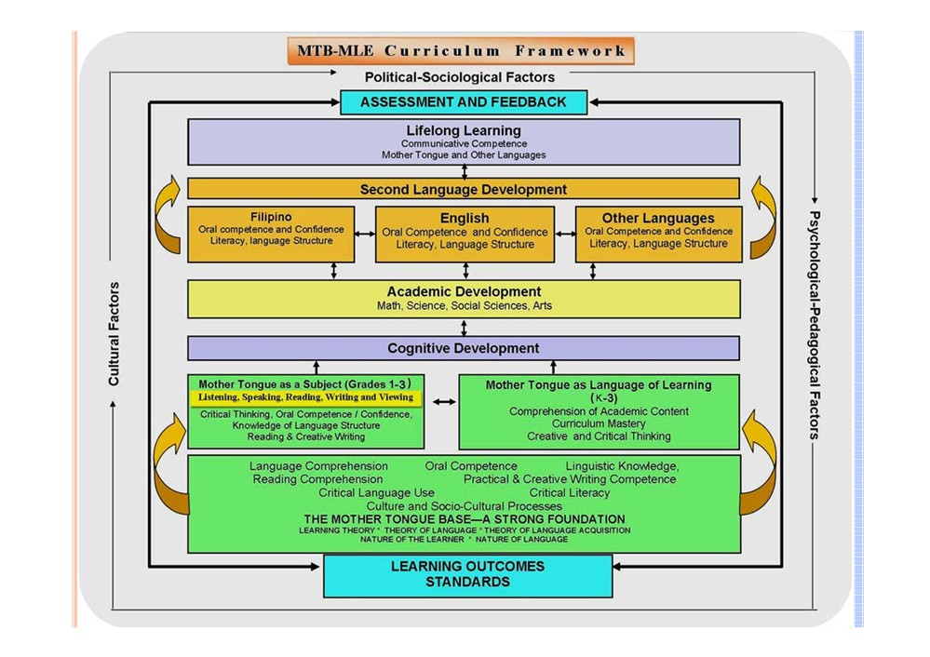

Slide 36
TAKING THE RIGHT STEPS….
| National Strategic Planning for the Country- wide Implementation of Mother Tongue - Based Multilingual Education (MTB-MLT)
a. Draft of Strategic Plan - November 2009 participated by 60+ educators, advocates, NGO education
practitioners
and DepEd personnel
b. Final Strategic Plan - February 2010

Slide 37
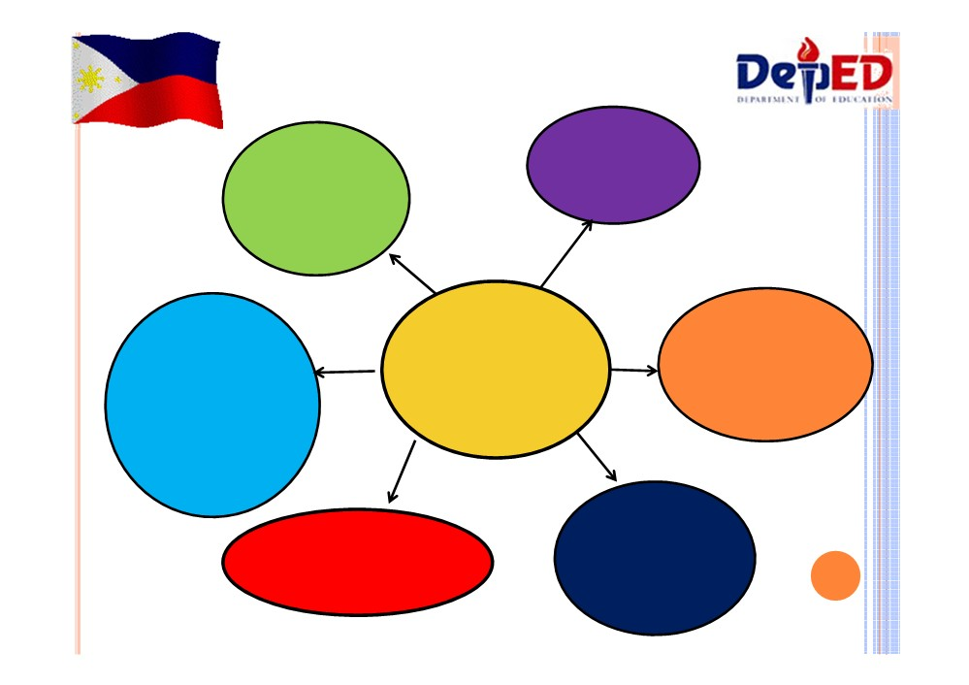
COMPONENTS OF MTB-MLE STRATEGIC PLAN
Pre-
Social
Service Teacher Education
Preparation and
Advocacy
Six
Policy
In-Service Training
Development and Resource Mobilization
Focused Areas
(INSET)
of Teachers and School Managers
Assessment,
Materials Development
Monitoring and
Evaluation

Slide 38
1. SOCIAL PREPARATION AND ADVOCACY
| Local celebration of Intl Mother Language Day every Feb
21 since 2008 in partnership with 170+ Talaytayan
| Production of MLE Primer and MLE Brochure
| 1st Philippine MLE Conference held in February 2010 attended by 1000 participants
| MTB-MLE Forum, West Visayas University, Iloilo City | Educ. Stakeholders Forum, Ateneo de Zamboanga | Kabikolan Conference, March 2011
| School, Division and Region based Mother Language Day Celebration through a DepEd memo
| Other local (Region and Division) initiatives
| Translator Association of the Philippines (TAP) | Summer Institute of Linguistics (SIL)

Slide 39
2. In-Service Training
(INSET) of Teachers and School Managers

Slide 40
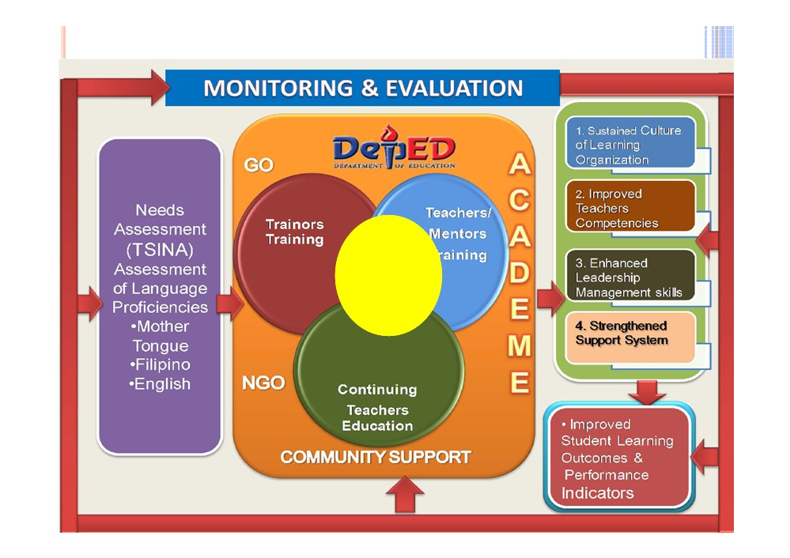
Figure I - Framework for MTBMLE CAPACITY DEVELOPMENT SYSTEM
PROFESSIONAL
DEVELOPMENT
Mode of Delivery
•Face to Face
•Web, E/
Learning
•School-Based Mentoring

Slide 41
Where are we now in terms of INSET…
| One - Month Summer Training for 53
Teachers from Luzon and Visaya Region
UP College of Education, Diliman, QC S- 2010
| One - Month Training for 10 Educators Payap University, Thailand, Sept. 2010

Slide 42
| MTB - MLE National Trainers Training (TOT) for
17 regions in 4 Phases
1. Phase I: Advocacy and Theoretical Foundations of MTB-MLE
October 2010 - DAP, Tagaytay City
100 MTB-MLE Regional Coordinators and Teachers
2. Phase II: Pedagogical Foundation MTB-MLE and Materials Development, November 2010, Iloilo City
105 MTB-MLE Regional Coordinators and Teachers
3. Phase III: Pedagogical Foundation and Research
January, 2011, Zamboanga City
4. Phase IV: Monitoring and Evaluation
March 19 - 28, 2011 , Cebu City

Slide 43
|Region/Division Initiated
Trainings: NCR, Rs-4A, 5, 6, 12 |TEI and Local Gov. Initiated Trainings
|MTB - MLE Region - wide
Training of Teachers by National Trainers with School Managers
- 120 teachers per region
- Summer 2011

Slide 44
3. MATERIALS DEVELOPMENT
|Region initiated Write-shops (Big Books and small books)
Bicol Region
Region VI Region XI
Region IV - A
CARAGA Region Region III
Region II
Region VI in partnership with TEI’s other regions

Slide 45
| Nation-wide initiated Write-shops on Materials Development - Graded Reading Big Books for 15 Languages (8 + Yakan, Chavacano,
Maguindanaon, Manobo, Sambal, Maranao, Tiboli
| Adapted Curriculum | Lessons Exemplars
| Primer lesson for 15 languages

Slide 46
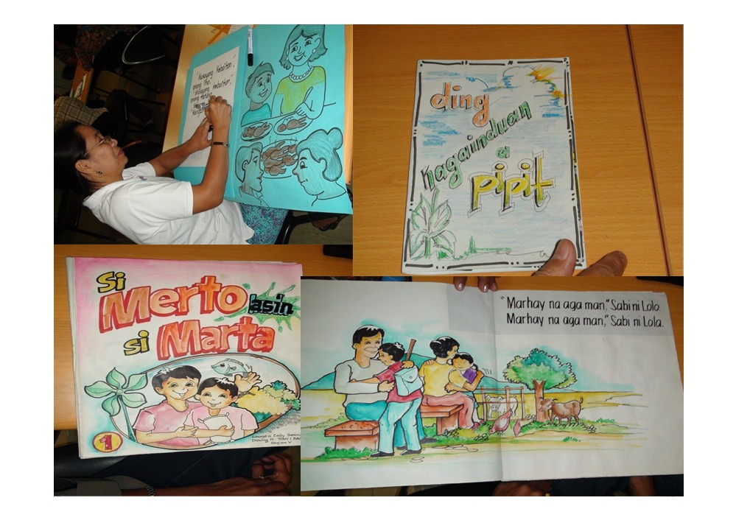

Slide 47
4. PRE-SERVICE TEACHER EDUCATION
| Partnership with …..
a. Philippine Normal University, Manila
b. University of the Philippines, Manila
c. West Visayas University, Iloilo City
d. Ateneo de Zamboanga Univ., Zamboanga City
e. Western Mindanao State Univ., Zamboanga City
f. Bicol University, Legaspi City
¾ Summer Training for the Teacher Education Institution (TEI) CHED Conference room, April 4 - 15, 2011

Slide 48
5. POLICY DEVELOPMENT & RESOURCE MOBILIZATION
| DepEd Order 60 s. 2008 (Addendum to DepEd Order 36 s. 2006)
| Issuance of Dept of Order 74 s. 2009- “Institutionalizing Mother Tongue Based Multilingual Education”
| MLE Country Strategic Plan
| Local Policies
MLE Resolutions:
y Pangasinan Provincial Board y Region 2 -RDC
y Naga City MLE resolution
y Ilocos Norte provincial resolution y La Union
y Cebu
y In support of the Gunigundo Bill

Slide 49
6. ASSESSMENT,
MONITORING AND EVALUATION
|DepEd - National Educational
Testing and Research Center
(NETRC) - Evaluation instruments written in 8 major languages
|M & E tool being crafted by TWG |Research on MTB-MLE being prepared
|Language Mapping

Slide 50
The
BRIDGING Process

Slide 51
SEQUENCING LEARNING THROUGH LANGUAGES
Kindergarten: Building of Foundation
¾ Build oral L1 through activities, stories, songs, poems, rhymes, games, etc.
¾ Introduce pre-reading activities in L1 including numeracy
¾ Build social development and love for learning and reading by listening and engaging in stories read aloud.

Slide 52
GRADE I - FOUNDATION SETTING
¾ Build children’s fluency and confidence in oral L1 by using the L1 and MOI in all subjects in activity -based lessons.
¾ Build knowledge by using L1 as MOI in all subjects. (Assessment in L1)
¾ Introduce reading and writing in L1
¾ Introduce oral Filipino focusing only on
listening and speaking activities to develop oral competence (Assess orally)
¾ Introduce oral English focusing only on
listening and speaking activities to develop oral competence. (Assess orally)

Slide 53
GRADE II: STRENGTHENING THE FOUNDATION
¾ Continue to build oral L1
¾ Continue building L1 Literacy
¾ Continue to develop oral Filipino and English for communicative competence
¾ Introduce Literacy in Filipino (Assess in Filipino)
¾ Introduce English Literacy in second semester allowing time to develop Filipino Literacy (Assess in English at the end of the year.)

Slide 54
GRADE III: BUILDING ON THE FOUNDATION
¾ Continue to build oral L1, Filipino and English ¾ Continue to develop literacy in L1 and Filipino and English for Fluency and Thinking
¾ Continue to use L1 to teach most subjects for comprehension and thinking
¾ Begin to use Filipino to teach Filipino domain subjects as students are able (with scaffolding)
¾ Begin to use English to teach English domain subjects as students are able (with scaffolding) in the second semester.

Slide 55
Continue oral development and Literacy in L1, L2, and L3
Continue oral and written L1 & L2 Continue Oral L3
Introduce Written L3
Continue oral L1 & L2 and written L1 Introduce Literacy in L2
Introduce Oral L3
Introducing 3
languages in
Continue oral L1
Introduce L1 literacy
Introduce Oral L2
“small steps” to build
Build oral L1
success

Slide 56
L1 - L2 - L1 TEACHING ACADEMIC
CONCEPTS
 Introduce the new concept in L1  Re-teach it in L2
 Review it in L1
 Important: “Understand the concept and use the L2 to explain and use what they have learned.
 Emphasis on Meaningful Learning
 Math, Science, Social Studies are concept but also language teaching times.

Slide 57
Kindergarten
Grade I
Grade 2
Grade 3
Build fluency in oral L1
MT as Subject
MT as subject
MT as subject
Build fluency in oral L1
Introduce
Bridging to Filipino Literacy
Introduce L1 literacy
Literacy in Filipino
(L2)
L1 pre
Begin oral Filipino, (Second grading)
Bridging to English Literacy
reading & pre writing
Continue building oral English
Begin Oral English (Second Semester or Third Grading)
Introduce L3 Literacy in the 2nd grading
Math, Science, Araling Panlipunan, Edukasyon sa
Math
Pagpapakatao, MAPEH in L1 with bridging in
Math
Araling Palipunan, Edukasyong sa Pagpapakatao, MAPEH in L1
Araling Panlipunan, Edukasyon sa
language of learning
Pagpapakatao, MAPEH in L1
L1 as LOI
L1 as LOI Begin introducing L2 & L3 Word Bank
L2-reading & writing L3-oral
L1-L2-L1 as LOI L1-L3-L1 as LOI
L1 as LOI
L2 - L1- L2 L3 - L2 - L3

Slide 58
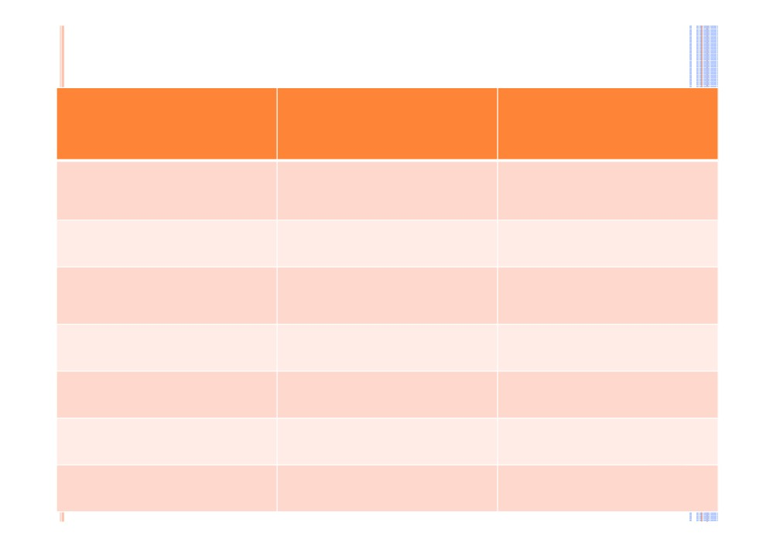
GRADE I - Learning Areas
Learning Area
Time Allotment
Medium of
Instruction
Edukasyon sa
40
Mother tongue
Pagpapakatao
Math
40
MT
Araling Panlipunan
30
MT
MAPEH
30
MT
Mother Tongue
40
English
30
(oral fluency)
Filipino
30
(oral fluency)

Slide 59
CLASS MODELS

Slide 60
CLASS MODELS
Situation
Class Model
1. Basic Monolingual
1. One School - One
Class One Language
2. Basic Monolingual (group students according to
2. One School - Two Classess - Two
language & match it with the teacher)
Languages
3. Modified Monolingual
a. Group the class according to
3. One School - Several Classess - Several Languages
Laguage & match it with the teacher
a.1 One class can be monolingual a.2 One or two classes can be bi-
or tri- lingual (assistance from the parents who are
native speakers is necessary)

Slide 61
CLASS MODELS
4. One School- Multiple
| Lingua Franca (use of
Languages - Multiple
the community
Classess
language)

Slide 62
MTBMLE BRIDGING PLAN IN A 3 YEAR PROGRAM
FIRST LANGUAGE AS L1, FILIPINO AS L2, ENGLISH AS L3
Grade
L1
Math
Sci
MAPEH
Edukasy
Araling
Fil
Eng
III
on sa Panlipun
Pagpapa an katao
Grade L1
Math MAPEH Edukasy Araling Fil
Oral then RW Eng
II
on sa Panlipun LSRW Pagpapa an
katao
Grade I L1 - L, S,
Math MAPEH Edukasy Araling Oral
Oral Eng
R, W, V
on sa Panlipun Fil Pagpapa an
katao
K
Mother Tongue - language, math, values etc.

Slide 63
MTBMLE BRIDGING PLAN IN A 3 YEAR PROGRAM L1 AS FILIPINO, L2 AS ENGLISH, ANOTHER L3
Grade
L1 Fil
Math
Sci
MAPEH
Edukasy
Araling
L3 LSRW
Eng
III
on sa Panlipun
Pagpapa an katao
Grade L1 Fil
Math
MAPEH Edukasy Araling Oral
Oral then RW Eng
II
on sa Panlipun L3
Pagpapa an katao
Grade I L1 - L, S,
Math
MAPEH Edukasy Araling Oral
Oral Eng
R, W, V
on sa Panlipun L3
Pagpapa an katao
K
Mother Tongue - language, math, values etc.

Slide 64
MTBMLE BRIDGING PLAN IN A 3 YEAR PROGRAM L1 AS ENGLISH, L2 AS FILIPINO, ANOTHER L3
Grade III
L1 Eng
Math
Sci
MAPEH
Edukasy
Araling
Fil LSRW
Oral then
on sa
Panlipun
RW L3
Pagpapa
an
katao
Grade II
L1 Eng
Math
MAPEH
Edukasy
Araling
Oral
Oral L3
on sa
Panlipun
Fil
Pagpapa
an
katao
Grade I
L1 - L, S,
Math
MAPEH
Edukasy
Araling
Oral
Oral L3
R, W, V
on sa
Panlipun
Fil
Pagpapa
an
katao
K
Mother Tongue - language, math, values etc.

Slide 65
MTBMLE Bridging Plan in a 3 year program
L1 First Language, L2 Filipino, L3 English, L4 Arabic
Grade III
L1
Math
Sci
MAPEH
Eduka
L2
Araling
L4
Eng
syon
Panlipun
sa
an
Pagpa
pakata
o
Grade II
L1
Math
MAPEH
Eduka
L2 LSRW
Araling
Oral then
syon
Panlipun
L4
RW
sa
an
Eng
Pagpa
pakata
o
Grade I
L1 - L, S,
Math
MAPEH
Eduka
Oral L2
Araling
L4
Oral
R, W, V
syon
Panlipun
Eng
sa
an
Pagpa
pakata
o
K
Mother Tongue - language, math, values, socio-cultural processes etc.

